Slide 1
Text Mining (Part I: Phrase Mining & Entity Typing)
Jiawei Han
Computer Science
University of Illinois at Urbana-Champaign
March 16, 2017

Slide 2


Slide 3
Outline
Why Text to Networks?
Phrase Mining and Topic Modeling from Large Text Corpora
Why Phrase Mining
Previous Approaches
TopMine
SegPhrase and AutoPhrase
Entity Recognition and Typing for Massive Text Data
ClusType: Entity Extraction and Typing by Relational Graph Construction and Propagation
Refined Entity Typing: PLE and AFET
CoType: Joint Typing of Entities and Relations

Slide 4
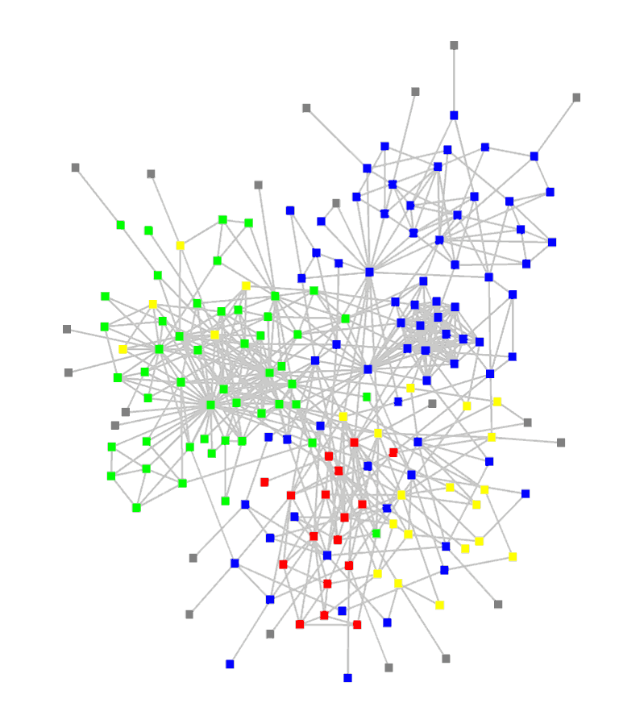
Why Text to Networks?
The major challenge for data scientists of our time
The Data-to-Knowledge (D2K) challenge
Big Data: Over 80% of our data is from text/natural language/social media, unstructured, noisy, dynamic, unreliable, …, but interconnected!
Keys from big data to big knowledge:
Structuring (i.e., transforming unstructured text into structured, typed, interconnected entities/relationships)
Networking (take advantage of massive, structured connections)
Mining/reasoning (e.g., induction/deduction) effectively on massive, relatively structured, interconnected networks
D2K game → D2N2K (Data to Network to Knowledge) game
→ Construction and mining of typed, heterogeneous information networks

Slide 5
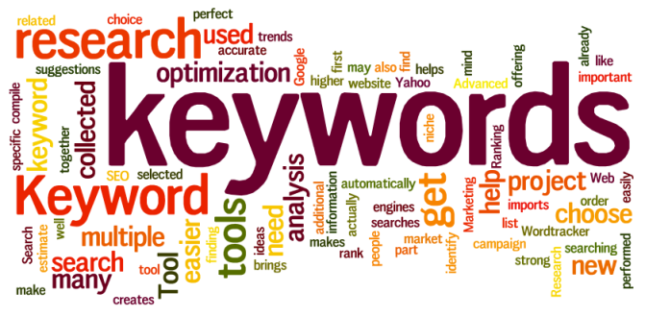

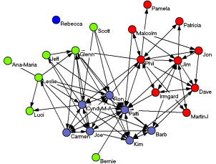







Construction: Structures Facilitate Information Mining
Network construction: Generate structured networks from unstructured text data
Automated mining of phrases, topics, entities, links and types from large corpora
Constructing types, heterogeneous networks from mined data
Text Corpus
Phrases
Knowledge
Heterog. networks
General KB
Typed entities

Slide 6
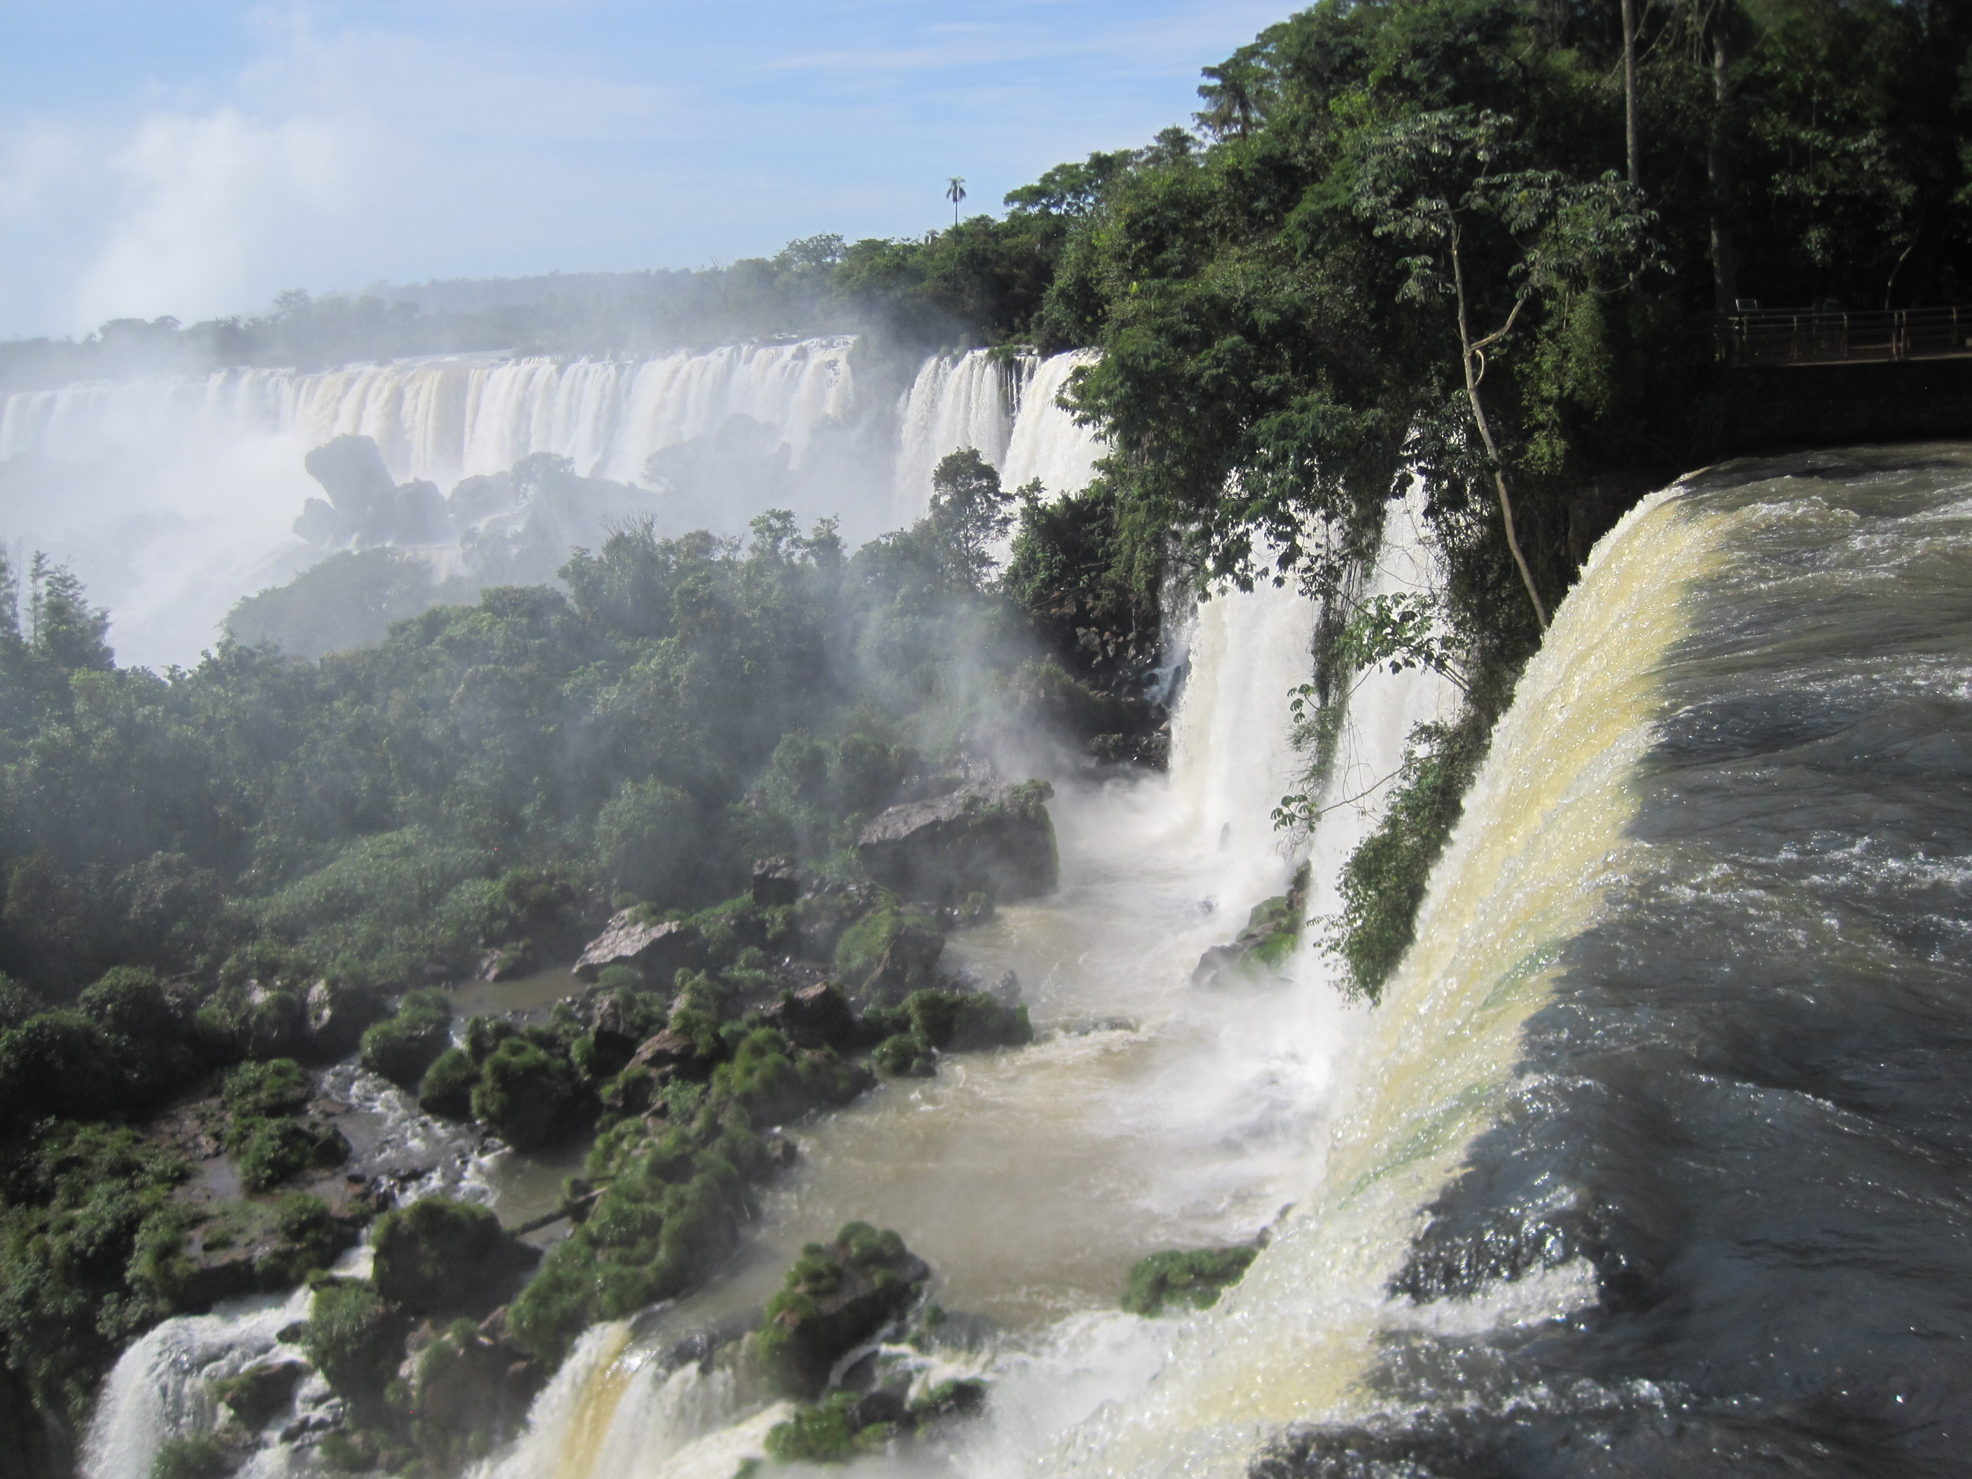

Slide 7
Outline
Why Text to Networks?
Phrase Mining and Topic Modeling from Large Text Corpora
Why Phrase Mining
Previous Approaches
TopMine
SegPhrase and AutoPhrase
Entity Recognition and Typing for Massive Text Data
ClusType: Entity Extraction and Typing by Relational Graph Construction and Propagation
Refined Entity Typing: PLE and AFET
CoType: Joint Typing of Entities and Relations

Slide 8
Why Phrase Mining?
Unigrams vs. phrases
Unigrams (single words) are ambiguous
Example: “United”: United States? United Airline? United Parcel Service?
Phrase: A natural, meaningful, unambiguous semantic unit
Example: “United States” vs. “United Airline”
Mining semantically meaningful phrases
Transform text data from word granularity to phrase granularity
Enhance the power and efficiency at manipulating unstructured data using database technology

Slide 9
Mining Phrases: Why Not Use NLP Methods?
Phrase mining: Originated from the NLP community—“Chunking”
Model it as a sequence labeling problem (B-NP, I-NP, O, …)
Need annotation and training
Annotate hundreds of documents as training data
Train a supervised model based on part-of-speech features
Recent trend:
Use distributional features based on web n-grams (Bergsma et al., 2010)
State-of-the-art performance: ~95% accuracy, ~88% phrase-level F-score
Limitations
High annotation cost, not scalable to a new language, a new domain or genre
May not fit domain-specific, dynamic, emerging applications
Scientific domains, query logs, or social media, e.g., Yelp, Twitter

Slide 10
Data Mining Approaches
General principle: Fully exploit information redundancy and data-driven criteria to determine phrase boundaries and salience
Phrase Mining and Topic Modeling from Large Corpora
Strategy 1: Simultaneously Inferring Phrases and Topics
Strategy 2: Post Topic Modeling Phrase Construction
Strategy 3: First Phrase Mining then Topic Modeling (ToPMine)
Integration of Phrase Mining with Document Segmentation

Slide 11
Frequent Pattern Mining for Text Data: Phrase Mining and Topic Modeling
Motivation: Unigrams (single words) can be difficult to interpret
Ex.: The topic that represents the area of Machine Learning
learning
reinforcement
support
machine
vector
selection
feature
random
:
learning
support vector machines
reinforcement learning
feature selection
conditional random fields
classification
decision trees
:
versus

Slide 12
Outline
Why Text to Networks?
Phrase Mining and Topic Modeling from Large Text Corpora
Why Phrase Mining
Previous Approaches
TopMine
SegPhrase and AutoPhrase
Entity Recognition and Typing for Massive Text Data
ClusType: Entity Extraction and Typing by Relational Graph Construction and Propagation
Refined Entity Typing: PLE and AFET
CoType: Joint Typing of Entities and Relations

Slide 13
Various Strategies: Phrase-Based Topic Modeling
Strategy 1: Generate bag-of-words → generate sequence of tokens
Bigram topical model [Wallach’06], topical n-gram model [Wang, et al.’07], phrase discovering topic model [Lindsey, et al.’12]
Strategy 2: Post bag-of-words model inference, visualize topics with n-grams
Label topic [Mei et al.’07], TurboTopic [Blei & Lafferty’09], KERT [Danilevsky, et al.’14]
Strategy 3: Prior bag-of-words model inference, mine phrases and impose on the bag-of-words model
ToPMine [El-kishky, et al.’15]

Slide 14
Strategy 1: Simultaneously Inferring Phrases and Topics
Bigram Topic Model [Wallach’06]
Probabilistic generative model that conditions on previous word and topic when drawing next word
Topical N-Grams (TNG) [Wang, et al.’07]
Probabilistic model that generates words in textual order
Create n-grams by concatenating successive bigrams (a generalization of Bigram Topic Model)
Phrase-Discovering LDA (PDLDA) [Lindsey, et al.’12]
Viewing each sentence as a time-series of words, PDLDA posits that the generative parameter (topic) changes periodically
Each word is drawn based on previous m words (context) and current phrase topic
High model complexity: Tends to overfitting; High inference cost: Slow

Slide 15
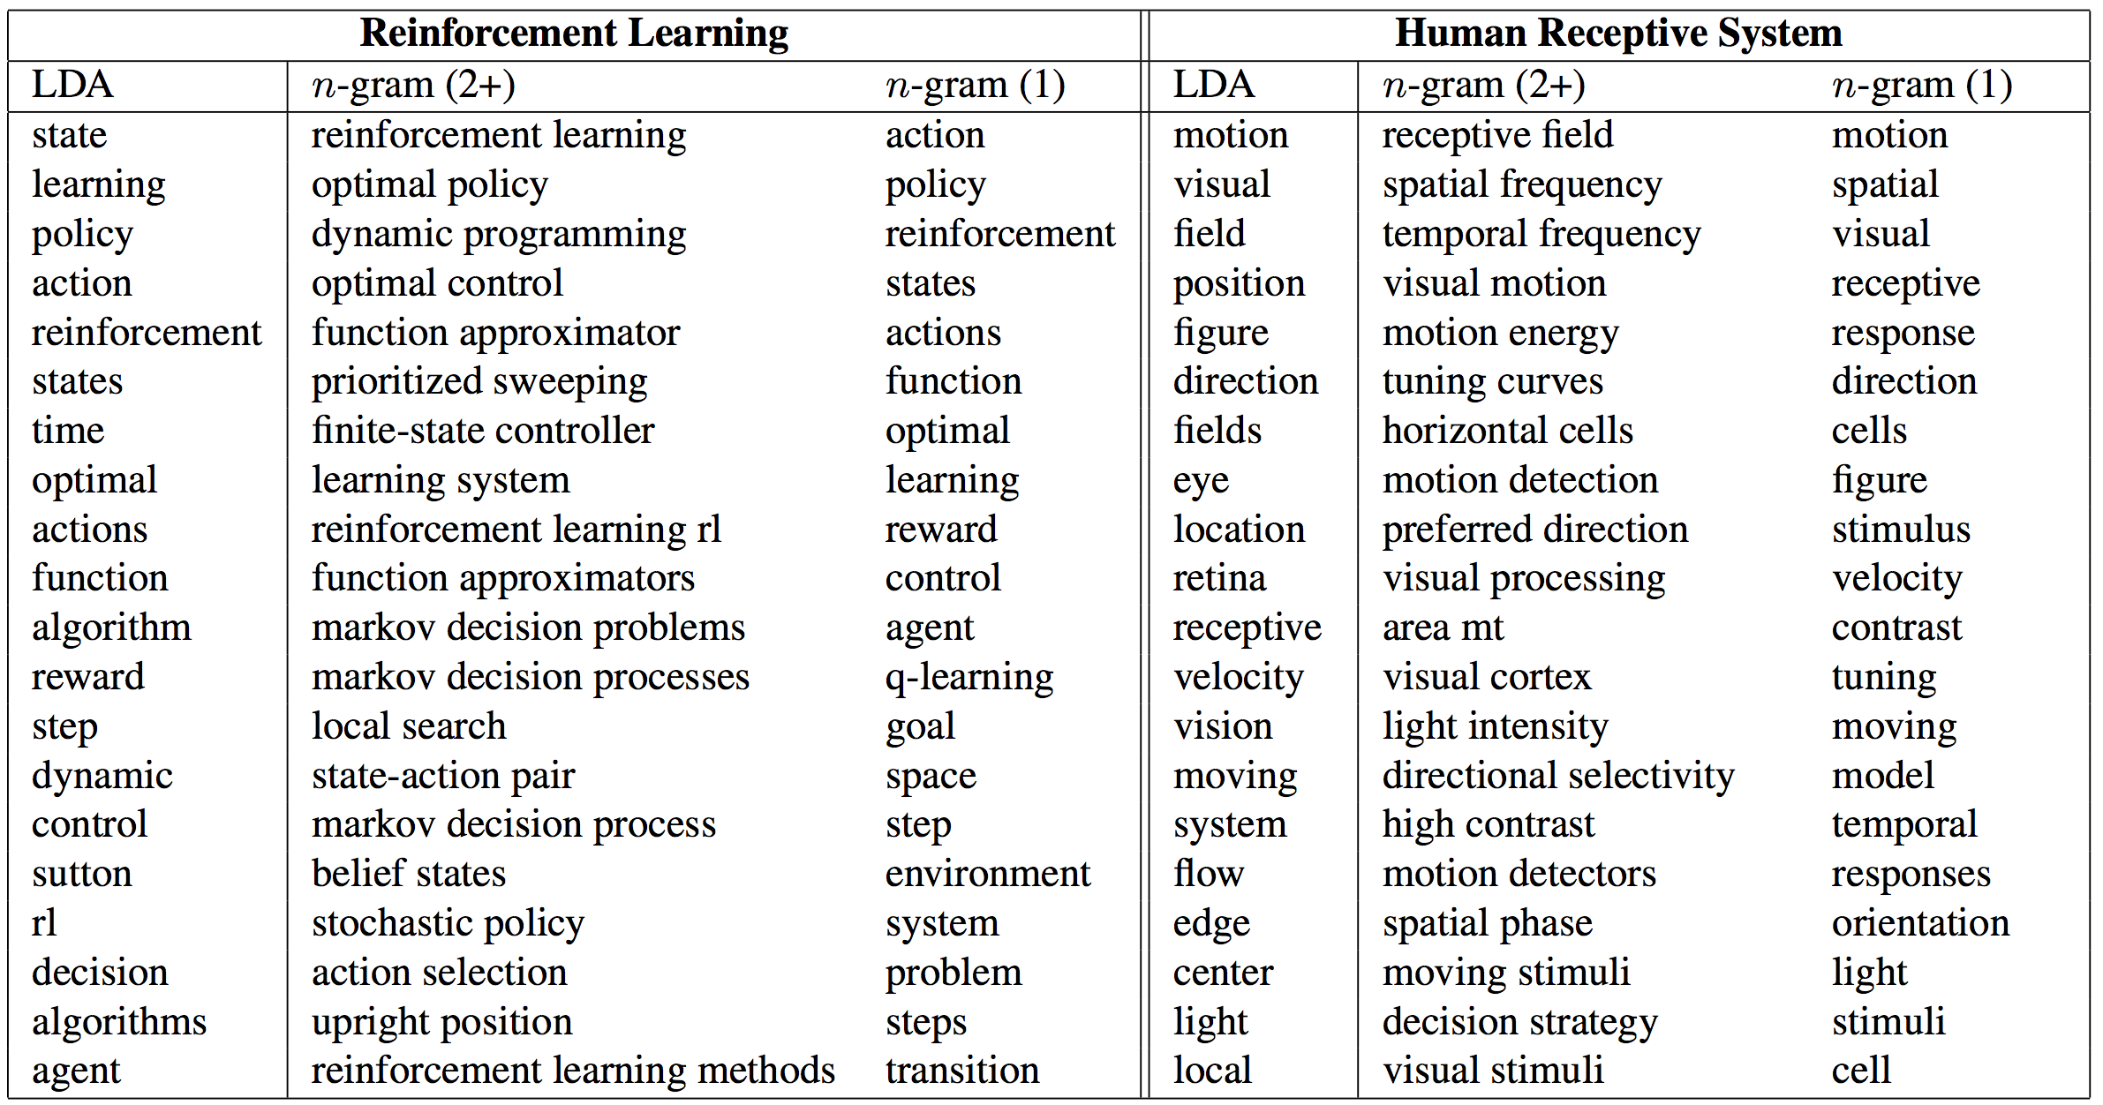
TNG: Experiments on Research Papers
Notes:
An interesting comparison
A state of the art phrase-discovering topic model

Slide 16
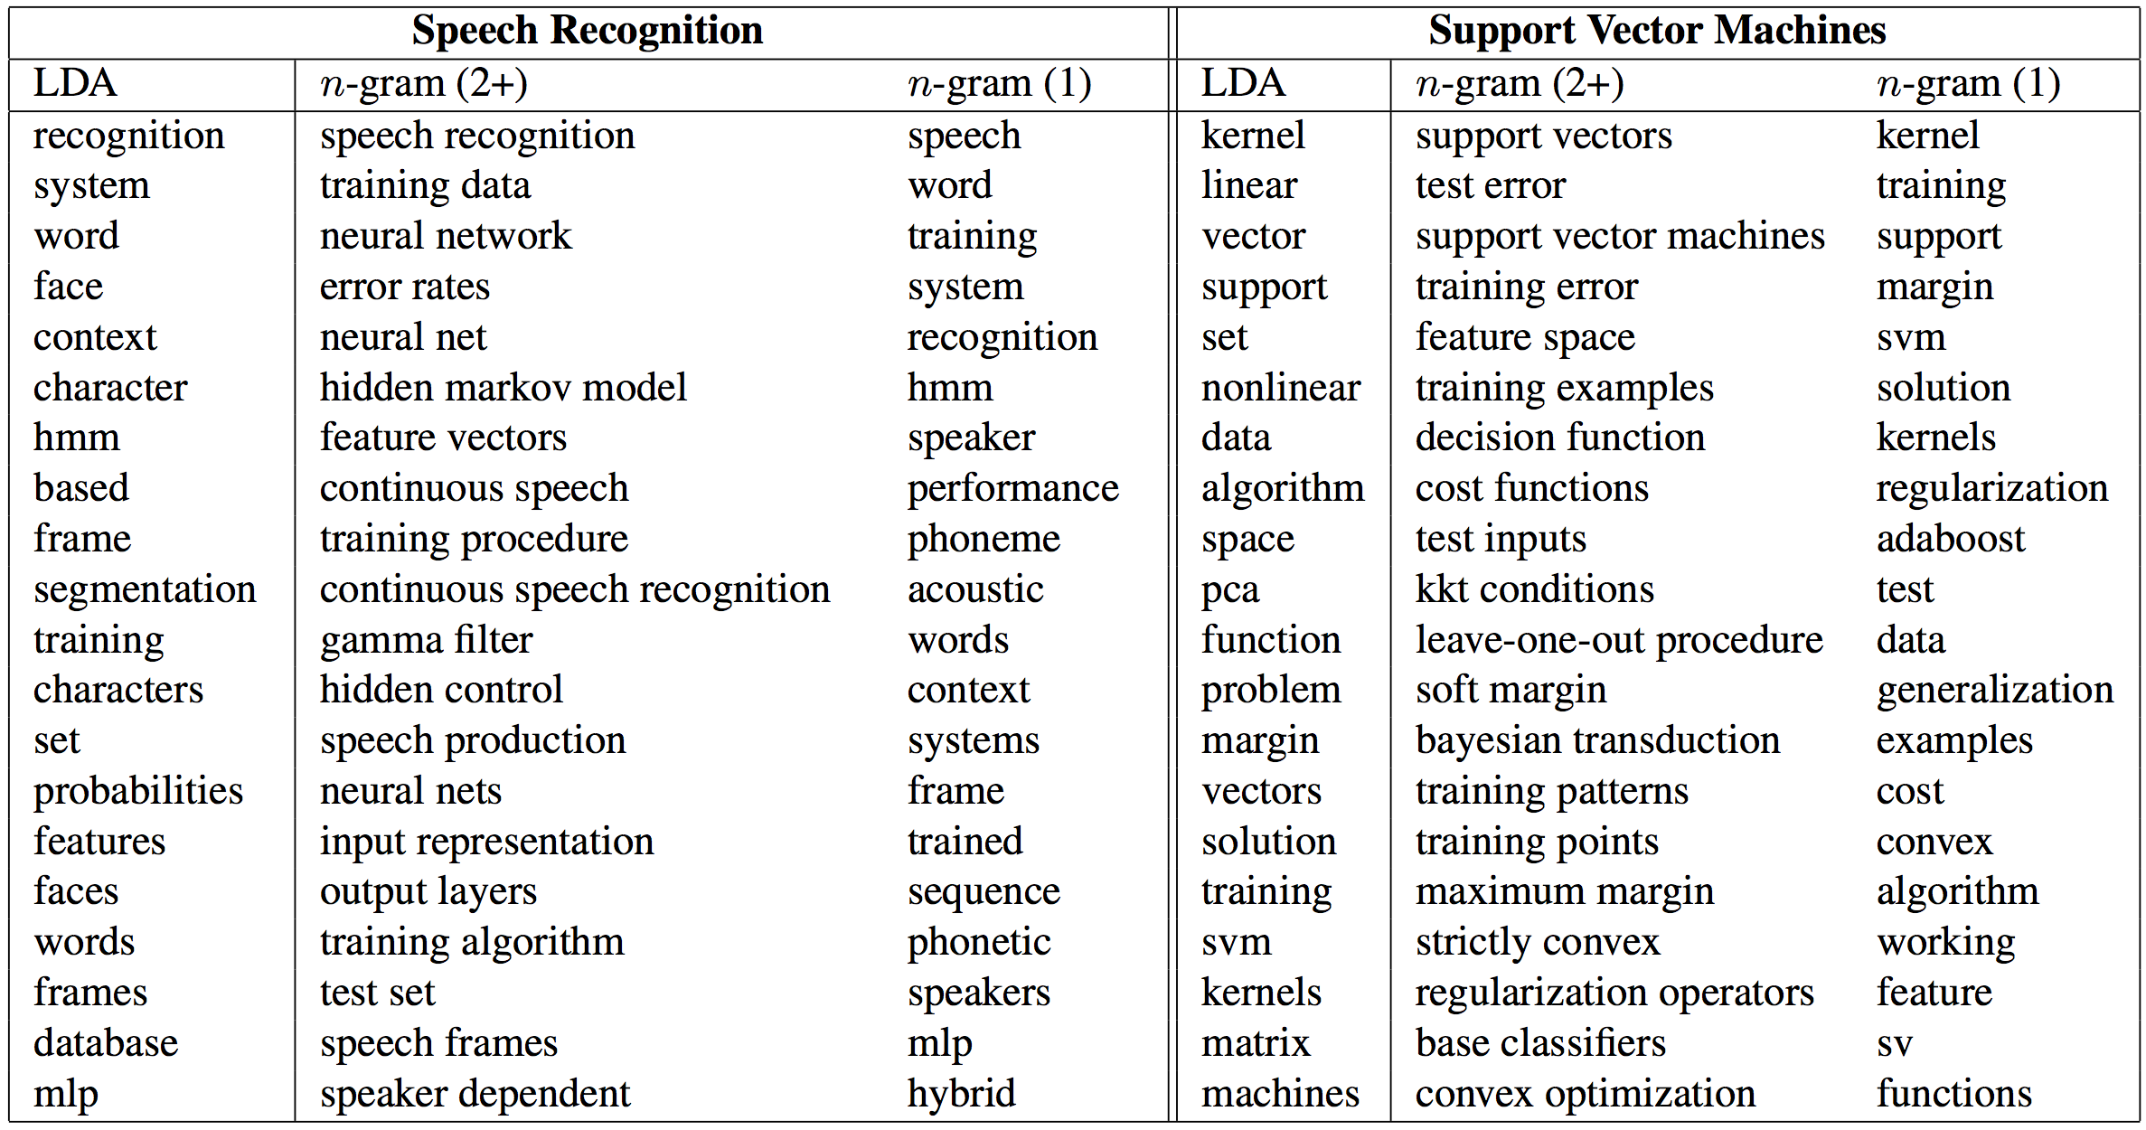
TNG: Experiments on Research Papers (2)
Notes:
An interesting comparison
A state of the art phrase-discovering topic model

Slide 17
Strategy 2: Post Topic Modeling Phrase Construction
TurboTopics [Blei & Lafferty’09] – Phrase construction as a post-processing step to Latent Dirichlet Allocation
Perform Latent Dirichlet Allocation on corpus to assign each token a topic label
Merge adjacent unigrams with the same topic label by a distribution-free permutation test on arbitrary-length back-off model
End recursive merging when all significant adjacent unigrams have been merged
KERT [Danilevsky et al.’14] – Phrase construction as a post-processing step to Latent Dirichlet Allocation
Perform frequent pattern mining on each topic
Perform phrase ranking based on four different criteria

Slide 18
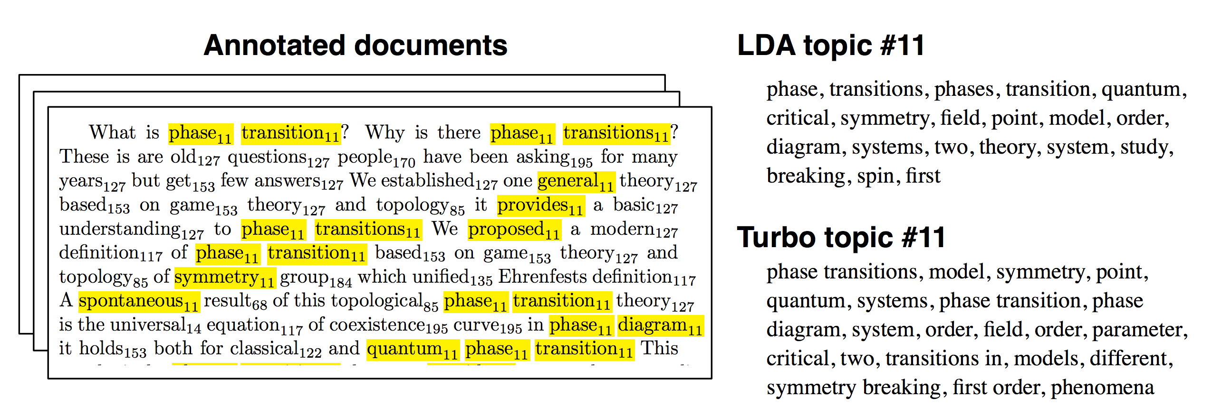
Example of TurboTopics
Perform LDA on corpus to assign each token a topic label
E.g., … phase₁₁ transition₁₁ …. game₁₅₃ theory₁₂₇ …
Then merge adjacent unigrams with same topic label

Slide 19
KERT: Topical Keyphrase Extraction & Ranking [Danilevsky, et al. 2014]
knowledge discovery using least squares support vector machine classifiers
support vectors for reinforcement learning
a hybrid approach to feature selection
pseudo conditional random fields
automatic web page classification in a dynamic and hierarchical way
inverse time dependency in convex regularized learning
postprocessing decision trees to extract actionable knowledge
variance minimization least squares support vector machines
…
learning
support vector machines
reinforcement learning
feature selection
conditional random fields
classification
decision trees
:
Topical keyphrase
extraction & ranking
Unigram topic assignment: Topic 1 & Topic 2

Slide 20
Framework of KERT
Run bag-of-words model inference and assign topic label to each token
Extract candidate keyphrases within each topic
Rank the keyphrases in each topic
Popularity: ‘information retrieval’ vs. ‘cross-language information retrieval’
Discriminativeness: only frequent in documents about topic t
Concordance: ‘active learning’ vs.‘learning classification’
Completeness: ‘vector machine’ vs. ‘support vector machine’
Frequent pattern mining
Comparability property: directly compare phrases of mixed lengths

Slide 21
Comparison of phrase ranking methods
KERT: Topical Phrases on Machine Learning
Top-Ranked Phrases by Mining Paper Titles in DBLP
kpRel [Zhao et al. 11] | KERT (-popularity) | KERT (-discriminativeness) | KERT (-concordance) | KERT [Danilevsky et al. 14]
learning | effective | support vector machines | learning | learning
classification | text | feature selection | classification | support vector machines
selection | probabilistic | reinforcement learning | selection | reinforcement learning
models | identification | conditional random fields | feature | feature selection
algorithm | mapping | constraint satisfaction | decision | conditional random fields
features | task | decision trees | bayesian | classification
decision | planning | dimensionality reduction | trees | decision trees
: | : | : | : | :
The topic that represents the area of Machine Learning

Slide 22


Slide 23
Outline
Why Text to Networks?
Phrase Mining and Topic Modeling from Large Text Corpora
Why Phrase Mining
Previous Approaches
TopMine
SegPhrase and AutoPhrase
Entity Recognition and Typing for Massive Text Data
ClusType: Entity Extraction and Typing by Relational Graph Construction and Propagation
Refined Entity Typing: PLE and AFET
CoType: Joint Typing of Entities and Relations

Slide 24
Strategy 3: First Phrase Mining then Topic Modeling
ToPMine [El-Kishky et al. VLDB’15]
First phrase construction, then topic mining
Contrast with KERT: topic modeling, then phrase mining
The ToPMine Framework:
Perform frequent contiguous pattern mining to extract candidate phrases and their counts
Perform agglomerative merging of adjacent unigrams as guided by a significance score—This segments each document into a “bag-of-phrases”
The newly formed bag-of-phrases are passed as input to PhraseLDA, an extension of LDA, that constrains all words in a phrase to each sharing the same latent topic

Slide 25
Why First Phrase Mining then Topic Modeling ?
With Strategy 2, tokens in the same phrase may be assigned to different topics
Ex. knowledge discovery using least squares support vector machine classifiers…
Knowledge discovery and support vector machine should have coherent topic labels
Solution: switch the order of phrase mining and topic model inference
Techniques
Phrase mining and document segmentation
Topic model inference with phrase constraint
[knowledge discovery] using [least squares] [support vector machine] [classifiers] …
[knowledge discovery] using [least squares] [support vector machine] [classifiers] …

Slide 26
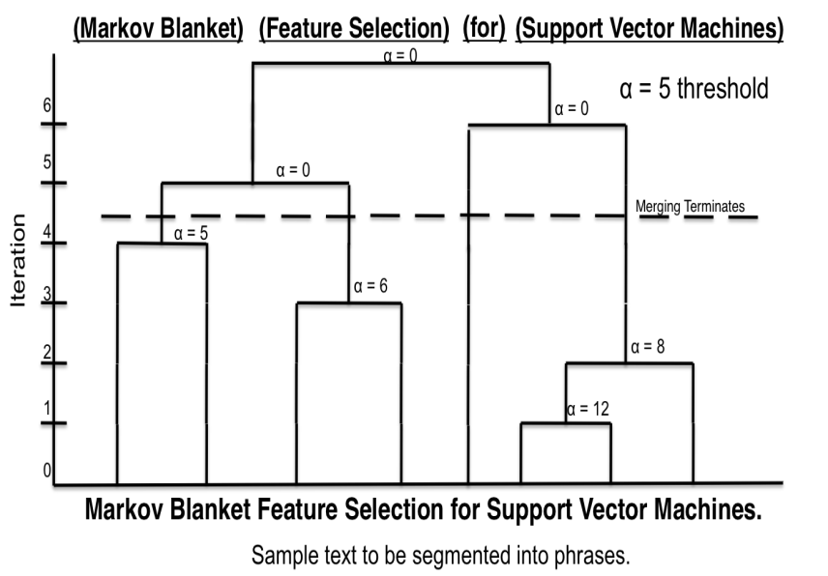
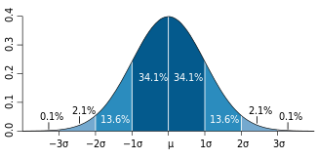
Phrase Mining: Frequent Pattern Mining + Statistical Analysis
Quality phrases
Based on significance score [Church et al.’91]:
α(P₁, P₂) ≈ (f(P₁●P₂) ̶ µ₀(P₁,P₂))/√ f(P₁●P₂)
[Markov blanket] [feature selection] for [support vector machines]
[knowledge discovery] using [least squares] [support vector machine] [classifiers]
…[support vector] for [machine learning]…
Phrase | Raw freq. | True freq.
[support vector machine] | 90 | 80
[vector machine] | 95 | 0
[support vector] | 100 | 20

Slide 27
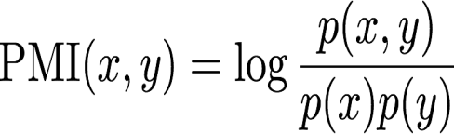
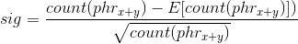
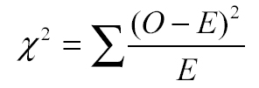
Collocation Mining
Collocation: A sequence of words that occur more frequently than expected
Often “interesting” and due to their non-compositionality, often relay information not portrayed by their constituent terms (e.g., “made an exception”, “strong tea”)
Many different measures used to extract collocations from a corpus [Dunning 93, Pederson 96]
E.g., mutual information, t-test, z-test, chi-squared test, likelihood ratio
Many of these measures can be used to guide the agglomerative phrase-segmentation algorithm

Slide 28
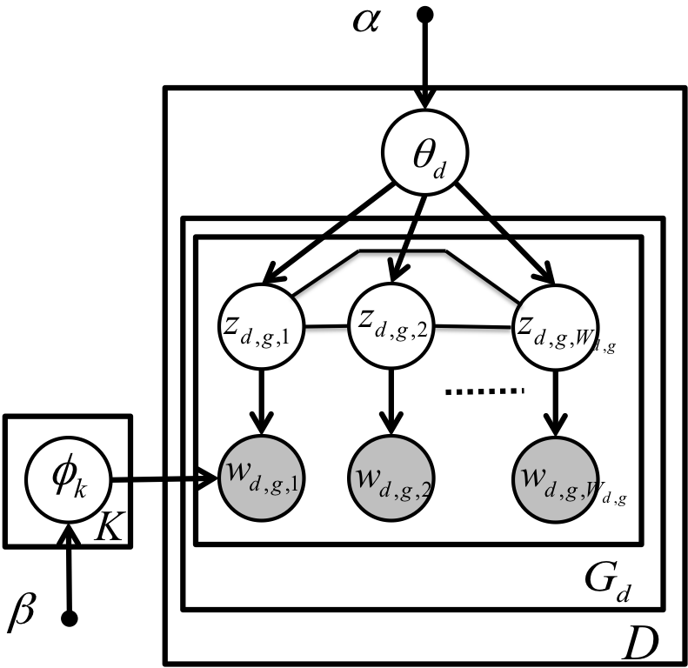
ToPMine: Phrase LDA (Constrained Topic Modeling)
The generative model for PhraseLDA is the same as LDA
Difference: the model incorporates constraints obtained from the “bag-of-phrases” input
Chain-graph shows that all words in a phrase are constrained to take on the same topic values
[knowledge discovery] using [least squares] [support vector machine] [classifiers] …
Topic model inference with phrase constraints

Slide 29
Example Topical Phrases: A Comparison
social networks | information retrieval
web search | text classification
time series | machine learning
search engine | support vector machines
management system | information extraction
real time | neural networks
decision trees | text categorization
: | :
Topic 1 | Topic 2
information retrieval | feature selection
social networks | machine learning
web search | semi supervised
search engine | large scale
information extraction | support vector machines
question answering | active learning
web pages | face recognition
: | :
Topic 1 | Topic 2
PDLDA [Lindsey et al. 12] Strategy 1 (3.72 hours)
ToPMine [El-kishky et al. 14]
Strategy 3 (67 seconds)
Notes:
An interesting comparison
A state of the art phrase-discovering topic model

Slide 30
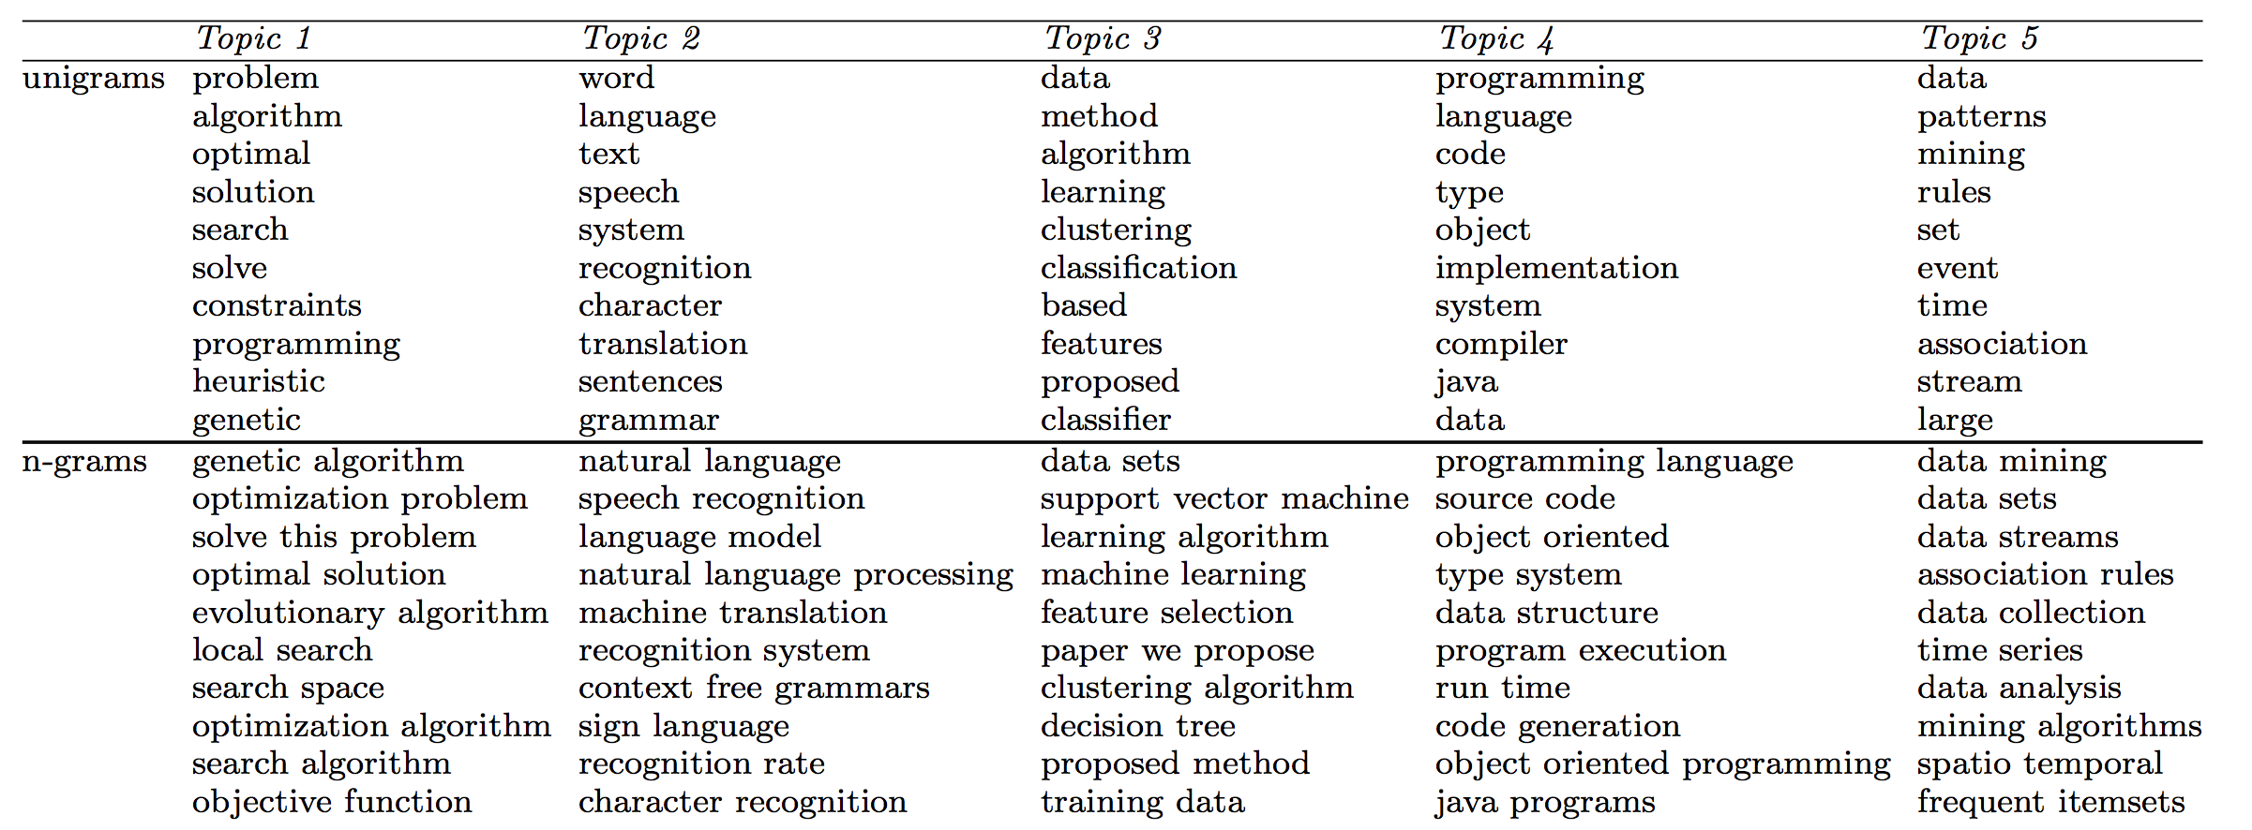
ToPMine: Experiments on DBLP Abstracts
Notes:
An interesting comparison
A state of the art phrase-discovering topic model

Slide 31
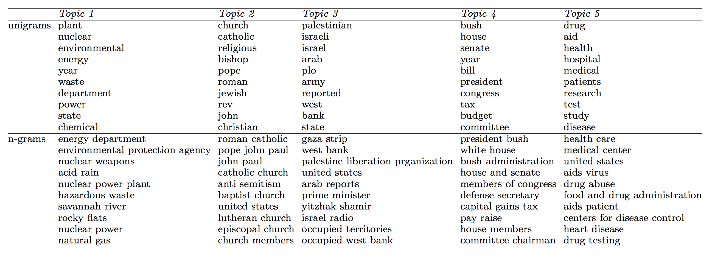
ToPMine: Topics on Associate Press News (1989)
Notes:
An interesting comparison
A state of the art phrase-discovering topic model

Slide 32
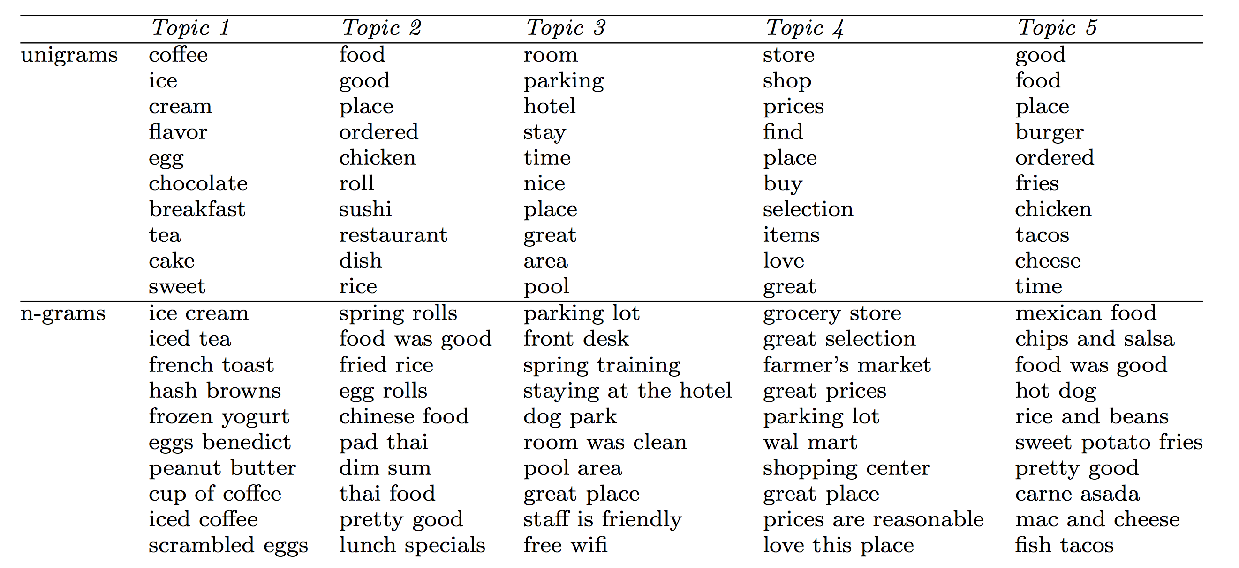

ToPMine: Experiments on Yelp Reviews
Notes:
An interesting comparison
A state of the art phrase-discovering topic model

Slide 33
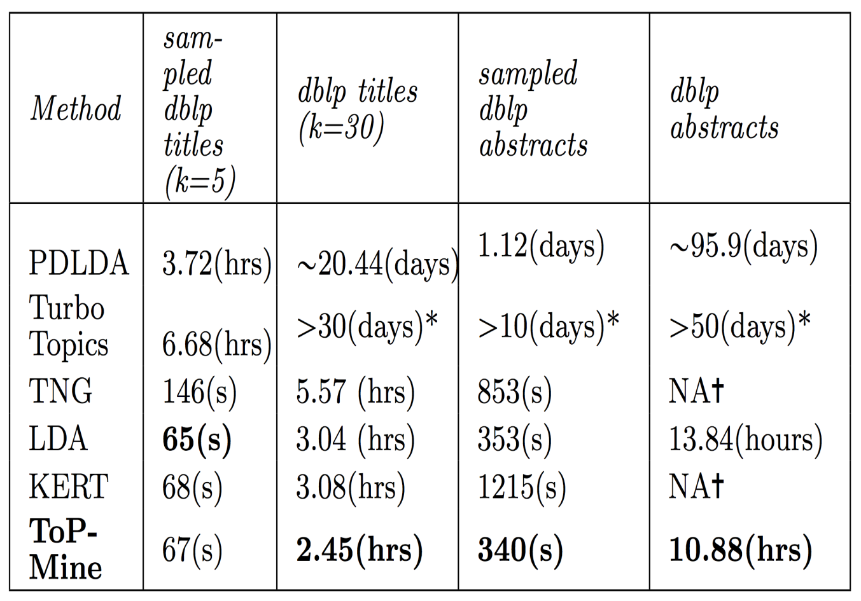
Efficiency: Running Time of Different Strategies
Running time: strategy 3 > strategy 2 > strategy 1 (“>” means outperforms)
Strategy 1: Generate bag-of-words → generate sequence of tokens
Strategy 2: Post bag-of-words model inference, visualize topics with n-grams
Strategy 3: Prior bag-of-words model inference, mine phrases and impose to the bag-of-words model

Slide 34
Coherence of Topics: Comparison of Strategies
Coherence measured by z-score: strategy 3 > strategy 2 > strategy 1
Strategy 1: Generate bag-of-words → generate sequence of tokens
Strategy 2: Post bag-of-words model inference, visualize topics with n-grams
Strategy 3: Prior bag-of-words model inference, mine phrases and impose to the bag-of-words model

Slide 35
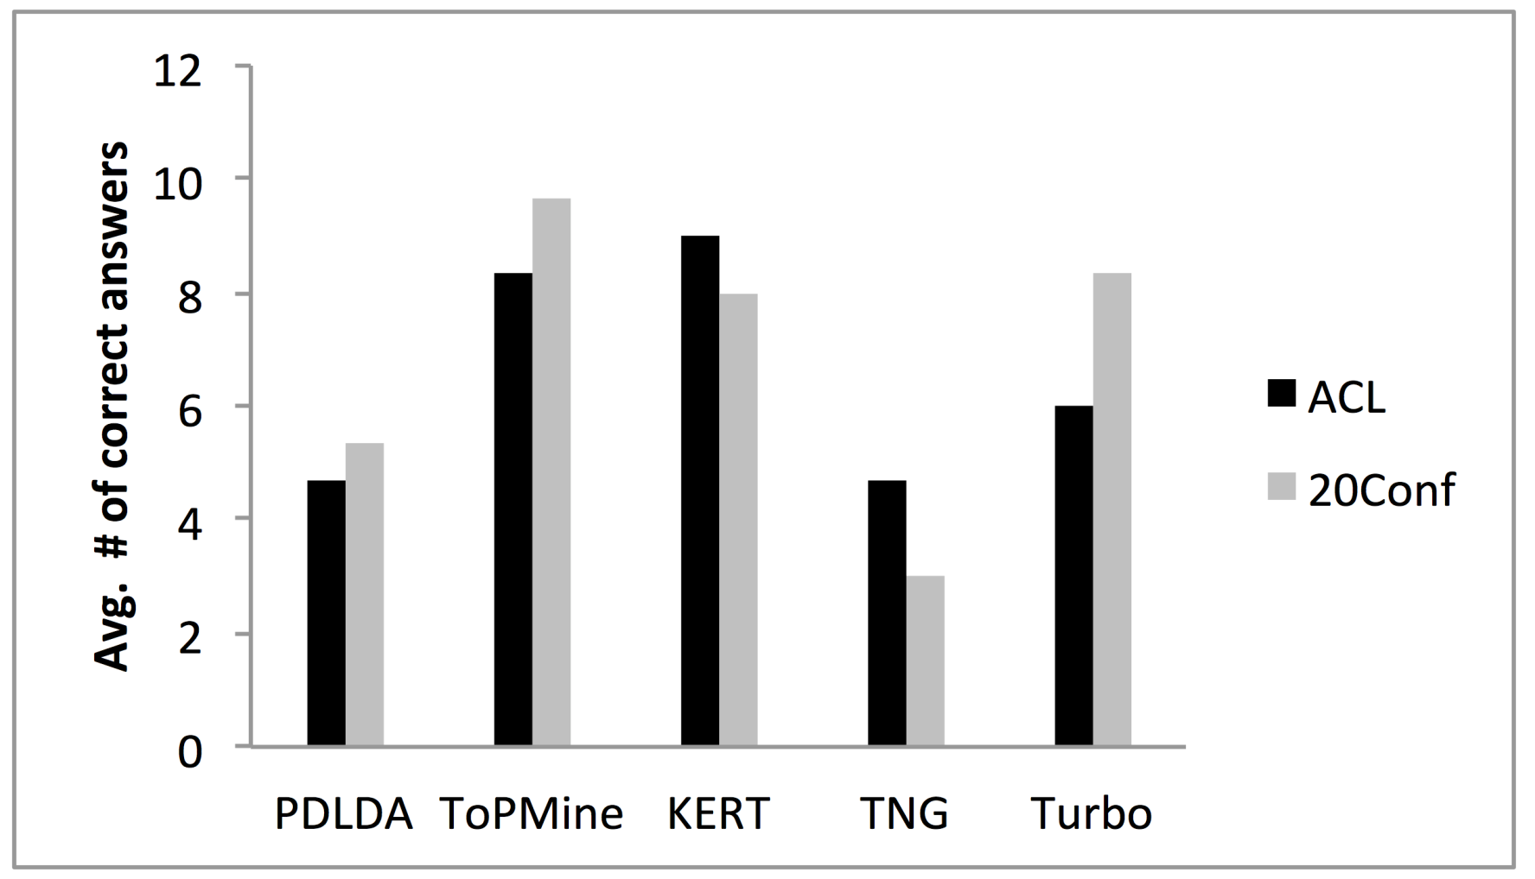
Phrase Intrusion: Comparison of Strategies
Phrase intrusion measured by average number of correct answers: strategy 3 > strategy 2 > strategy 1

Slide 36
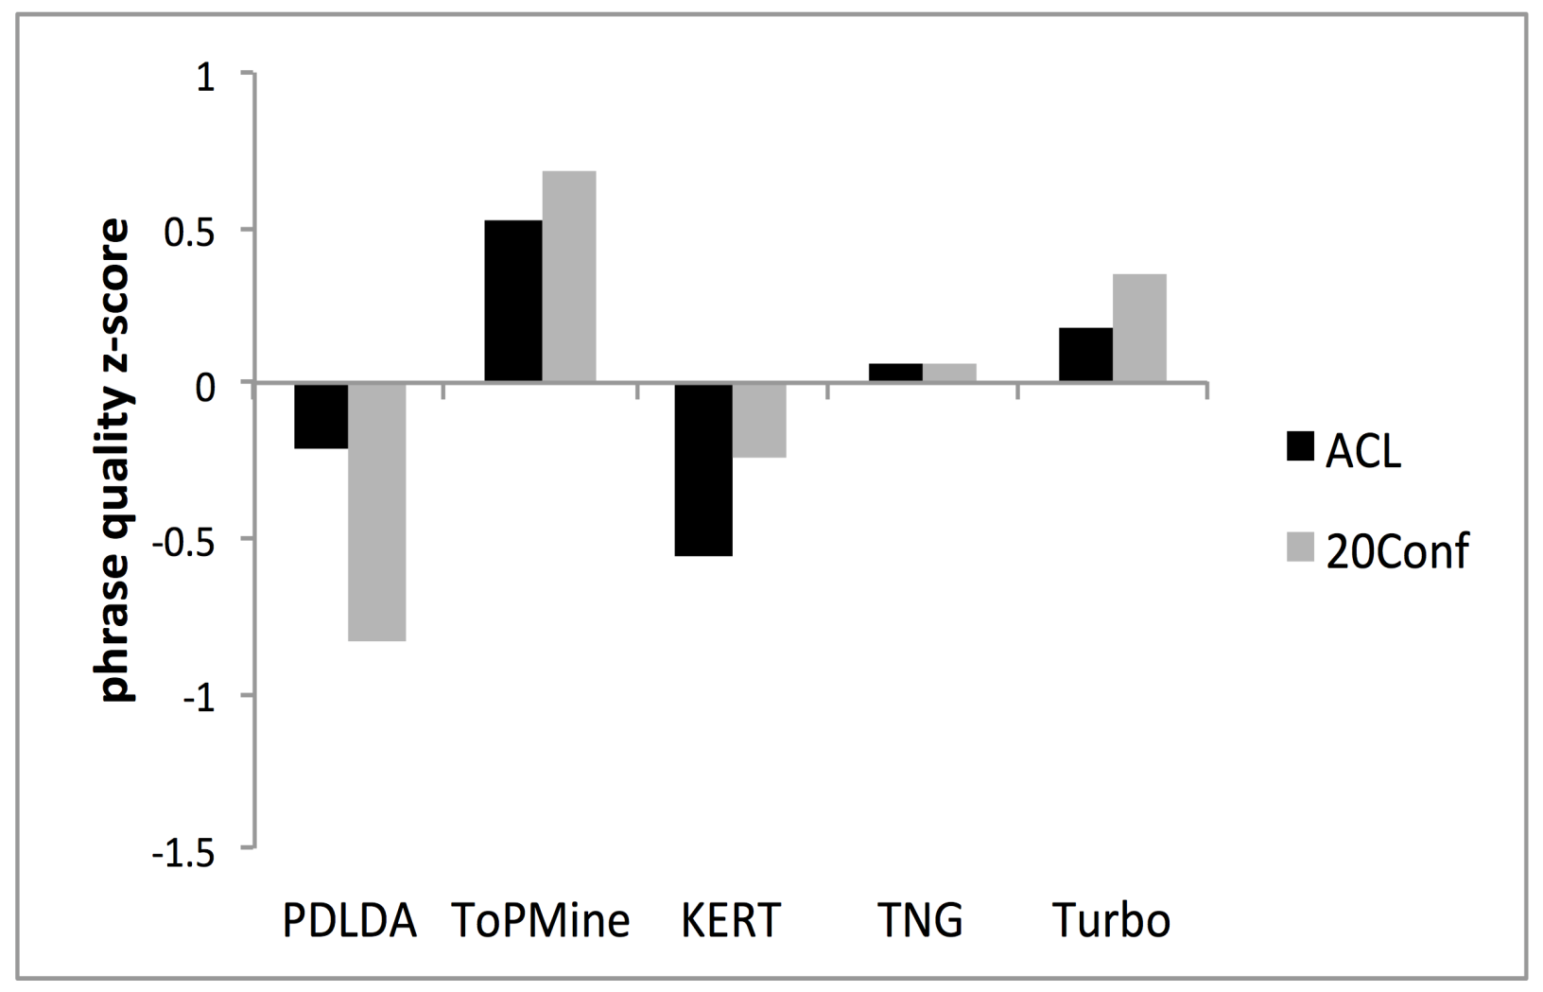
Phrase Quality: Comparison of Strategies
Phrase quality measured by z-score:
strategy 3 > strategy 2 > strategy 1

Slide 37
Summary: Strategies on Topical Phrase Mining
Strategy 1: Generate bag-of-words → generate sequence of tokens
Integrated complex model; phrase quality and topic inference rely on each other
Slow and overfitting
Strategy 2: Post bag-of-words model inference, visualize topics with n-grams
Phrase quality relies on topic labels for unigrams
Can be fast; generally high-quality topics and phrases
Strategy 3: Prior bag-of-words model inference, mine phrases and impose to the bag-of-words model
Topic inference relies on correct segmentation of documents, but not sensitive
Can be fast; generally high-quality topics and phrases

Slide 38


Slide 39
Outline
Why Text to Networks?
Phrase Mining and Topic Modeling from Large Text Corpora
Why Phrase Mining
Previous Approaches
TopMine
SegPhrase and AutoPhrase
Entity Recognition and Typing for Massive Text Data
ClusType: Entity Extraction and Typing by Relational Graph Construction and Propagation
Refined Entity Typing: PLE and AFET
CoType: Joint Typing of Entities and Relations

Slide 40
Mining Phrases: Why Not Use Raw Frequency Based Methods?
Traditional data-driven approaches
Frequent pattern mining
If AB is frequent, likely AB could be a phrase
Raw frequency could NOT reflect the quality of phrases
E.g., freq(vector machine) ≥ freq(support vector machine)
Need to rectify the frequency based on segmentation results
Phrasal segmentation will tell
Some words should be treated as a whole phrase whereas others are still unigrams

Slide 41

SegPhrase: From Raw Corpus to Quality Phrases and Segmented Corpus
Raw Corpus
Quality Phrases
Segmented Corpus
Document 1
Citation recommendation is an interesting but challenging research problem in data mining area.
Document 2
In this study, we investigate the problem in the context of heterogeneous information networks using data mining technique.
Document 3
Principal Component Analysis is a linear dimensionality reduction technique commonly used in machine learning applications.
Input Raw Corpus
Quality Phrases
Segmented Corpus
Phrase Mining
Phrasal Segmentation

Slide 42
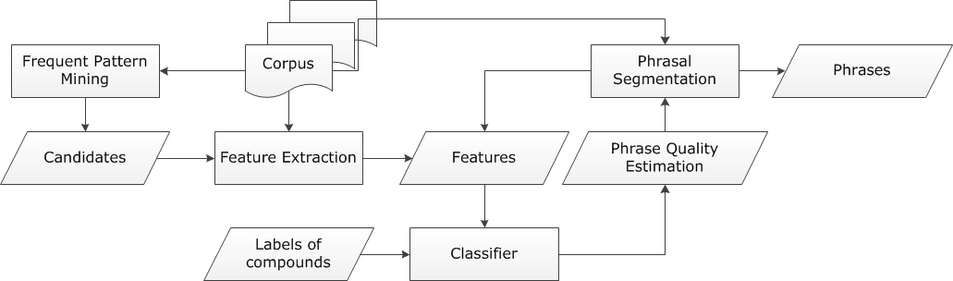
SegPhrase: The Overall Framework
ClassPhrase: Frequent pattern mining, feature extraction, classification
SegPhrase: Phrasal segmentation and phrase quality estimation
SegPhrase+: One more round to enhance mined phrase quality
ClassPhrase
SegPhrase(+)

Slide 43
What Kind of Phrases Are of “High Quality”?
Judging the quality of phrases
Popularity
“information retrieval” vs. “cross-language information retrieval”
Concordance
“powerful tea” vs. “strong tea”
“active learning” vs. “learning classification”
Informativeness
“this paper” (frequent but not discriminative, not informative)
Completeness
“vector machine” vs. “support vector machine”

Slide 44
ClassPhrase I: Pattern Mining for Candidate Set
Build a candidate phrases set by frequent pattern mining
Mining frequent k-grams
k is typically small, e.g. 6 in our experiments
Popularity measured by raw frequent words and phrases mined from the corpus

Slide 45
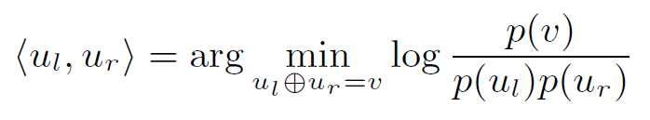
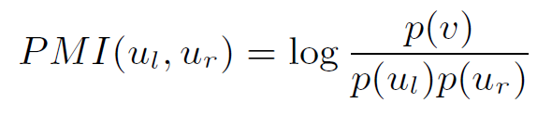
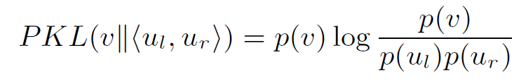
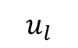
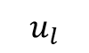
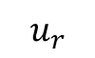
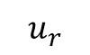
ClassPhrase II: Feature Extraction: Concordance
Partition a phrase into two parts to check whether the co-occurrence is significantly higher than pure random
support vector machine this paper demonstrates
Pointwise mutual information:
Pointwise KL divergence:
The additional p(v) is multiplied with pointwise mutual information, leading to less bias towards rare-occurred phrases
$$u_{l}$$
$$u_{r}$$
$$u_{l}$$
$$u_{r}$$

Slide 46
ClassPhrase II: Feature Extraction: Informativeness
Deriving Informativeness
Quality phrases typically start and end with a non-stopword
“machine learning is” vs. “machine learning”
Use average IDF over words in the phrase to measure the semantics
Usually, the probabilities of a quality phrase in quotes, brackets, or connected by dash should be higher (punctuations information)
“state-of-the-art”
We can also incorporate features using some NLP techniques, such as POS tagging, chunking, and semantic parsing

Slide 47
ClassPhrase III: Classifier
Limited Training
Labels: Whether a phrase is a quality one or not
“support vector machine”: 1
“the experiment shows”: 0
For ~1GB corpus, only 300 labels
Random Forest as our classifier
Predicted phrase quality scores lie in [0, 1]
Bootstrap many different datasets from limited labels

Slide 48
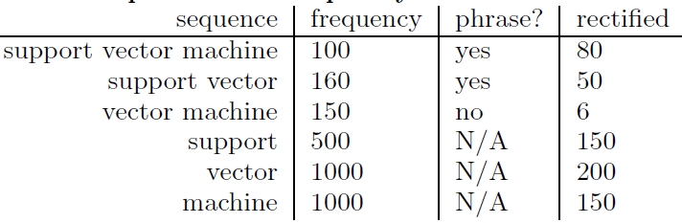
SegPhrase: Why Do We Need Phrasal Segmentation in Corpus?
Phrasal segmentation can tell which phrase is more appropriate
Ex: A standard [feature vector] [machine learning] setup is used to describe...
Rectified phrase frequency (expected influence)
Example:
Not counted towards the rectified frequency

Slide 49
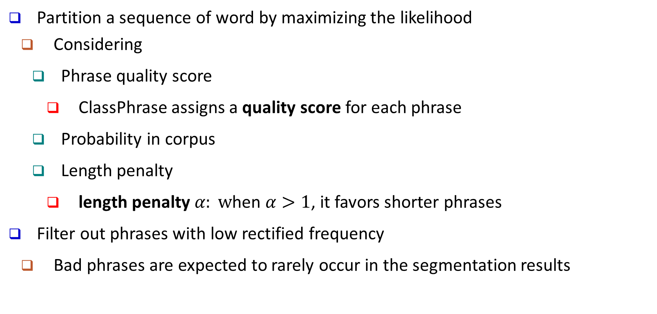
SegPhrase: Segmentation of Phrases
Partition a sequence of word by maximizing the likelihood
Considering
Phrase quality score
ClassPhrase assigns a quality score for each phrase
Probability in corpus
Length penalty
length penalty $α: w$hen $α>1$, it favors shorter phrases
Filter out phrases with low rectified frequency
Bad phrases are expected to rarely occur in the segmentation results

Slide 50
SegPhrase+: Enhancing Phrasal Segmentation
SegPhrase+: One more round for enhanced phrasal segmentation
Feedback
Using rectified frequency, re-compute those features previously computing based on raw frequency
Process
Classification → Phrasal segmentation // SegPhrase
Classification → Phrasal segmentation // SegPhrase+
Effects on computing quality scores
np hard in the strong sense
np hard in the strong
data base management system

Slide 51
Performance Study: Methods to Be Compared
Other phase mining methods: Methods to be compared
NLP chunking based methods
Chunks as candidates
Sorted by TF-IDF and C-value (K. Frantzi et al., 2000)
Unsupervised raw frequency based methods
ConExtr (A. Parameswaran et al., VLDB 2010)
ToPMine (A. El-Kishky et al., VLDB 2015)
Supervised method
KEA, designed for single document keyphrases (O. Medelyan & I. H. Witten, 2006)

Slide 52
Performance Study: Experimental Setting
Datasets
Popular Wiki Phrases
Based on internal links
~7K high quality phrases
Pooling
Sampled 500 * 7 Wiki-uncovered phrases
Evaluated by 3 reviewers independently
Dataset | #docs | #words | #labels
DBLP | 2.77M | 91.6M | 300
Yelp | 4.75M | 145.1M | 300

Slide 53
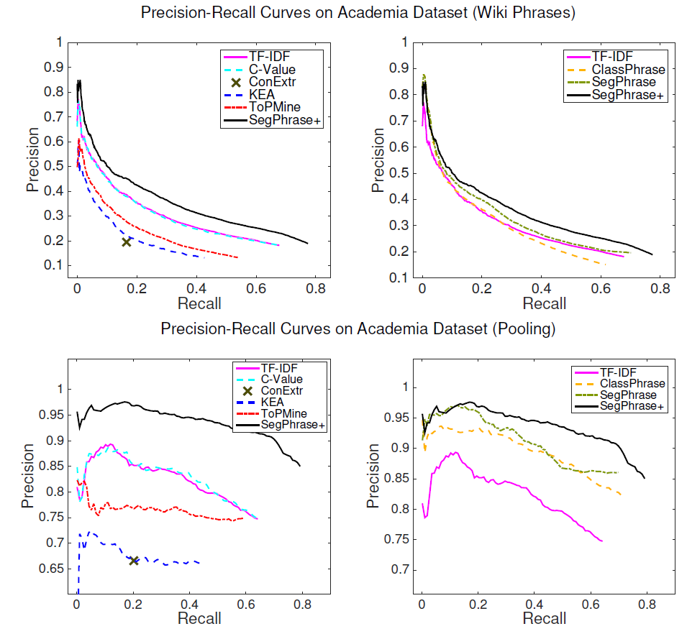
Performance: Precision Recall Curves on DBLP
Compare with other baselines
TF-IDF
C-Value
ConExtr
KEA
ToPMine
SegPhrase+
Compare with our 3 variations
TF-IDF
ClassPhrase
SegPhrase
SegPhrase+
53
Notes:
Then the picky audience might ask how to project phrase mining methods back to the corpus so we can get mention-level chunking results? Maybe during presentation we can emphasize that's not the goal, we think it's more interesting to discover important phrases from a large corpus without any manual annotations.

Slide 54
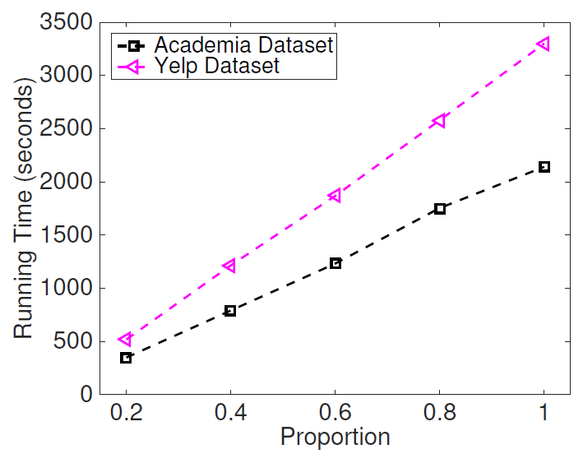
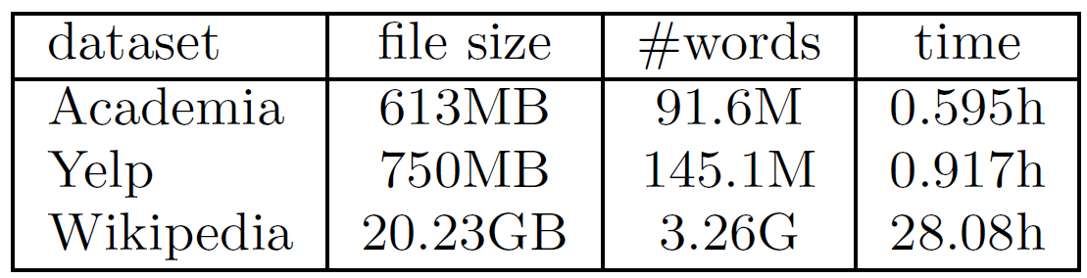
Performance Study: Processing Efficiency
SegPhrase+ is linear to the size of corpus!

Slide 55
Experimental Results: Interesting Phrases Generated (From the Titles and Abstracts of SIGMOD)
Query | SIGMOD
Method | SegPhrase+ | Chunking (TF-IDF & C-Value)
1 | data base | data base
2 | database system | database system
3 | relational database | query processing
4 | query optimization | query optimization
5 | query processing | relational database
… | … | …
51 | sql server | database technology
52 | relational data | database server
53 | data structure | large volume
54 | join query | performance study
55 | web service | web service
… | … | …
201 | high dimensional data | efficient implementation
202 | location based service | sensor network
203 | xml schema | large collection
204 | two phase locking | important issue
205 | deep web | frequent itemset
… | … | …
Only in SegPhrase+
Only in Chunking

Slide 56
Experimental Results: Interesting Phrases Generated (From the Titles and Abstracts of SIGKDD)
Query | SIGKDD
Method | SegPhrase+ | Chunking (TF-IDF & C-Value)
1 | data mining | data mining
2 | data set | association rule
3 | association rule | knowledge discovery
4 | knowledge discovery | frequent itemset
5 | time series | decision tree
… | … | …
51 | association rule mining | search space
52 | rule set | domain knowledge
53 | concept drift | importnant problem
54 | knowledge acquisition | concurrency control
55 | gene expression data | conceptual graph
… | … | …
201 | web content | optimal solution
202 | frequent subgraph | semantic relationship
203 | intrusion detection | effective way
204 | categorical attribute | space complexity
205 | user preference | small set
… | … | …
Only in SegPhrase+
Only in Chunking

Slide 57
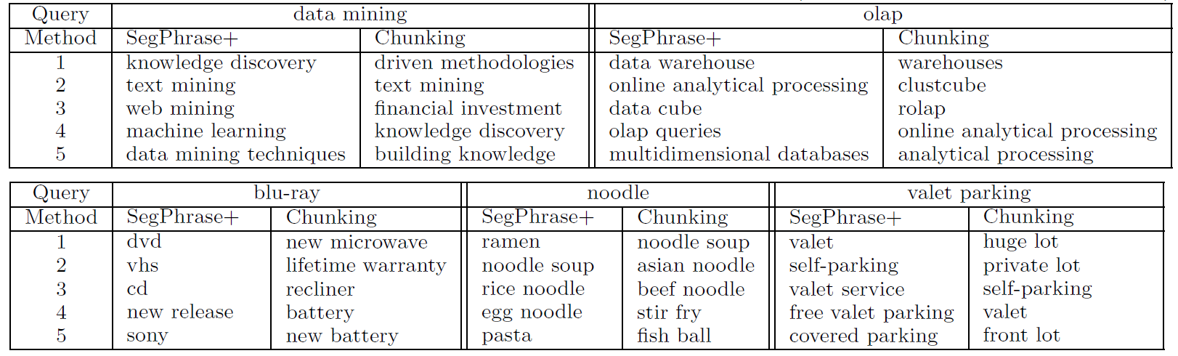
Experimental Results: Similarity Search
Find high-quality similar phrases based on user’s phrase query
In response to a user’s phrase query, SegPhrase+ generates high quality, semantically similar phrases
In DBLP, query on “data mining” and “OLAP”
In Yelp, query on “blu-ray”, “noodle”, and “valet parking”

Slide 58
Mining Quality Phrases in Multiple Languages
Both ToPMine and SegPhrase+ are extensible to mining quality phrases in multiple languages
SegPhrase+ on Chinese (From Chinese Wikipedia)
ToPMine on Arabic (From Quran (Fus7a Arabic)(no preprocessing)
Experimental results of Arabic phrases:
كفروا → Those who disbelieve
بسم الله الرحمن الرحيم→ In the name of God the Gracious and Merciful
Rank | Phrase | In English
… | … | …
62 | 首席_执行官 | CEO
63 | 中间_偏右 | Middle-right
… | … | …
84 | 百度_百科 | Baidu Pedia
85 | 热带_气旋 | Tropical cyclone
86 | 中国科学院_院士 | Fellow of Chinese Academy of Sciences
… | … | …
1001 | 十大_中文_金曲 | Top-10 Chinese Songs
1002 | 全球_资讯网 | Global News Website
1003 | 天一阁_藏_明代_科举_录_选刊 | A Chinese book name
… | … | …
9934 | 国家_戏剧_院 | National Theater
9935 | 谢谢_你 | Thank you
… | … | …

Slide 59


Slide 60
AutoPhrase: Automated Phrase Mining
Jingbo Shang, Jialu Liu, Meng Jiang, Xiang Ren, Clare R. Voss, Jiawei Han, “AutoPhrase: Automated Phrase Mining from Massive Text Corpora” submitted for pub. 2017
Automatic extraction of high-quality phrases (e.g., scientific terms and general entity names) in a given corpus (e.g., research papers and news)
No human efforts
Multiple languages
High performance—precision, recall, efficiency

Slide 61
AutoPhrase: Label Generation by Distant Supervision
Completely remove the human effort for labeling phrases
Distant training: Utilize high-quality phrases in KBs (e.g., Wiki) as positive phrase labels
Method: Sampling-based label generation
Positive Labels
Wikipedia contains many high-quality phrases in titles, keywords, and internal links
E.g., in Chinese, more than 20,000
Uniformly draw 100 samples as positive labels for single-word and multi-word phrases respectively
Negative Labels
Phrase candidates meeting the popularity requirement is huge in size and the majority of them are actually poor in quality (e.g., “francisco opera and”).
Ex. A small corpus in Chinese has about 4 million frequent phrase candidates, while more than 90% are not in good quality

Slide 62
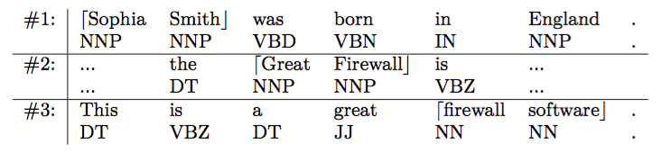
Generating High-Quality Phrases in Multi-Languages
Complicated pre-processing models, such as dependency parsing, heavily rely on human efforts and thus cannot be smoothly applied to multiple languages
Minimum Language Dependency = Tokenization + POS tagging
Drawbacks of Frequency-based signals only: Over-decomposition & Under-decomposition
“Sophia Smith” vs. “Sophia” and “Smith”
“Great Firewall” vs. “firewall software”
Drawbacks of POS only:
“classifier SVM” vs. “discriminative classifier” and “SVM”
Context-aware phrasal segmentation

Slide 63
Robust Positive-Only Distant Training
In each base classifier, randomly sample K positive (e.g., wiki titles, keywords, links) and K noisy negative labels from the pools
Noisy negative pool: δ quality phrases among the K negative labels
Perturbed training set: size-2K subset of the full set of all phrase where the labels of some quality phrases are switched from positive to negative
For each base classifier, we randomly draw K phrase candidates with replacement from the positive pool and the negative pool respectively
We grow an unpruned decision tree to the point of separating all phrases to meet this requirement
Use an ensemble classifier that averages the results of T independently trained base classifiers

Slide 64
Single-Word Modeling: Enhancing Recall
AutoPhrase: Simultaneously model single-word and multi-word phrases
A phrase is not only a group of multiple words, but also possibly a single word, as long as it functions as a constituent in the syntax of a sentence, e.g., “UIUC”, “Illinois”
Based on our experiments: 10%~30% quality phrases are single-word phrases
Modeling single-word phrases: Examining requirements of quality multi-word phrase
Popularity: sufficient frequent in the given corpus
Concordance: the collocation of tokens in such frequency that is significantly higher than random
Informativeness: indicative of a specific topic or concept
Completeness: Complete semantic unit
Only concordance cannot be defined in single-word phrases
Independence: A quality single-word phrase is more likely a complete semantic unit in the given documents

Slide 65
Experiments and Performance Comparison
Datasets:
Phrase Mining Results
Comparing methods
SegPhrase/WrapSegPhrae (encoding preprocessing for handling non-English)
TF-IDF/TextRank

Slide 66
References on Phrase Mining
D. M. Blei and J. D. Lafferty. Visualizing Topics with Multi-Word Expressions, arXiv:0907.1013, 2009
M. Danilevsky, C. Wang, N. Desai, X. Ren, J. Guo, J. Han. Automatic Construction and Ranking of Topical Keyphrases on Collections of Short Documents“, SDM’14
A. El-Kishky, Y. Song, C. Wang, C. R. Voss, and J. Han. Scalable Topical Phrase Mining from Text Corpora. VLDB’15
K. Frantzi, S. Ananiadou, and H. Mima, Automatic Recognition of Multi-Word Terms: the c-value/nc-value Method. Int. Journal on Digital Libraries, 3(2), 2000
R. V. Lindsey, W. P. Headden, III, M. J. Stipicevic. A phrase-discovering topic model using hierarchical pitman-yor processes, EMNLP-CoNLL’12.
J. Liu, J. Shang, C. Wang, X. Ren, J. Han, Mining Quality Phrases from Massive Text Corpora. SIGMOD’15
Jingbo Shang, Jialu Liu, Meng Jiang, Xiang Ren, Clare R. Voss, Jiawei Han, “AutoPhrase: Automated Phrase Mining from Massive Text Corpora” submitted for pub. 2017
O. Medelyan and I. H. Witten, Thesaurus Based Automatic Keyphrase Indexing. IJCDL’06
Q. Mei, X. Shen, C. Zhai. Automatic Labeling of Multinomial Topic Models, KDD’07
A. Parameswaran, H. Garcia-Molina, and A. Rajaraman. Towards the Web of Concepts: Extracting Concepts from Large Datasets. VLDB’10
X. Wang, A. McCallum, X. Wei. Topical n-grams: Phrase and topic discovery, with an application to information retrieval, ICDM’07

Slide 67


Slide 68
Outline
Why Text to Networks?
Phrase Mining and Topic Modeling from Large Text Corpora
Why Phrase Mining
Previous Approaches
TopMine
SegPhrase and AutoPhrase
Entity Recognition and Typing for Massive Text Data
ClusType: Entity Extraction and Typing by Relational Graph Construction and Propagation
Refined Entity Typing: PLE and AFET
CoType: Joint Typing of Entities and Relations

Slide 69
Why Entity Recognition and Typing from Massive Corpora?
Traditional named entity recognition systems are designed for major types (e.g., PER, LOC, ORG) and general domains (e.g., news)
Require additional steps to adapt to new domains/types
Expensive human labor on annotation
500 documents for entity extraction; 20,000 queries for entity linking
Unsatisfying agreement due to various granularity levels and scopes of types
Entities obtained by entity linking techniques have limited coverage and freshness
> 50% unlinkable entity mentions in Web corpus [Lin et al., EMNLP’12]
> 90% in our experiment corpora: tweets, Yelp reviews, …
A new approach: ClusType: Entity Recognition and Typing by Relation Phrase-Based Clustering [Ren, et al., KDD 2015]
Recognizing entity mentions of target types with minimal/no human supervision and with no requirement that entities can be found in a KB (distant supervision)

Slide 70



Recognizing Typed Entities
Identifying token span as entity mentions in documents and labeling their types
Target Types
The best BBQ I’ve tasted in Phoenix! I had the pulled pork sandwich with coleslaw and baked beans for lunch. ... The owner is very nice. …
The best BBQ:Food I’ve tasted in Phoenix:LOC ! I had the [pulled pork sandwich]:Food with coleslaw:Food and [baked beans]:Food for lunch. … The owner:JOB_TITLE is very nice. …
FOOD
LOCATION
JOB_TITLE
EVENT
ORGANIZATION
…
Plain text
Text with typed entities
FOOD
LOCATION
EVENT
Enabling structured analysis of unstructured text corpus

Slide 71
Traditional NLP Approach: Feature Engineering
Typical Entity Extraction Features (Li et al., 2012)
N-gram: Unigram, bigram and trigram token sequences in the context window
Part-of-Speech: POS tags of the context words
Gazetteers: person names, organizations, countries and cities, titles, idioms, etc.
Word clusters: word clusters / embeddings
Case and Shape: Capitalization and morphology analysis based features
Chunking: NP and VP Chunking tags
Global feature: Sentence level and document level structure/position features

Slide 72
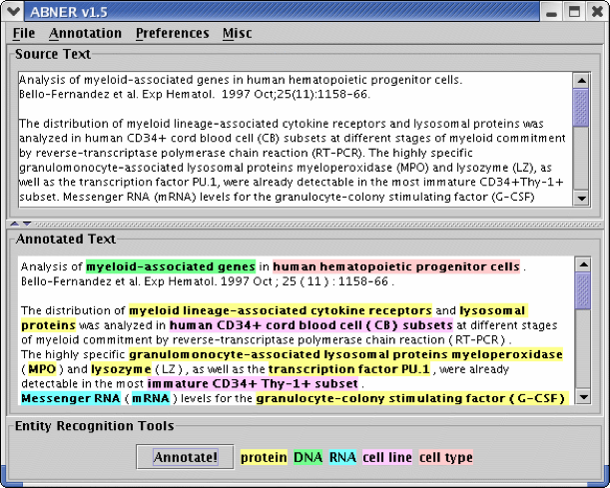
Traditional Named Entity Recognition (NER) Systems
Heavy reliance on human annotated data
Training sequence models is slow
The best [BBQ] I’ve tasted in [Phoenix].
The | best | BBQ | I’ve | tasted | in | Phoenix
O | O | Food | O | O | O | Location
Sequence model training
Systems:
Stanford NER
Illinois Name Tagger
IBM Alchemy APIs
…
A manual annotation interface
Finkel et al., Incorporating Non-local Information into Information Extraction Systems by Gibbs Sampling, ACL 2005
Notes:
To collect the task-specific training data, one needs to ask domain experts to read the corpus line by line, word by word to identify entity mention and also label their types
General philosophy is there

Slide 73
Traditional NLP Approach: Feature Engineering
Typical Entity Linking Features (Ji et al., 2011)
Mention/Concept Attribute |  | Description
Name | Spelling match | Exact string match, acronym match, alias match, string matching…
 | KB link mining | Name pairs mined from KB text redirect and disambiguation pages
 | Name Gazetteer | Organization and geo-political entity abbreviation gazetteers
Document surface | Lexical | Words in KB facts, KB text, mention name, mention text.
 |  | Tf.idf of words and ngrams
 | Position | Mention name appears early in KB text
 | Genre | Genre of the mention text (newswire, blog, …)
 | Local Context | Lexical and part-of-speech tags of context words
Entity Context | Type | Mention concept type, subtype
 | Relation/Event | Concepts co-occurred, attributes/relations/events with mention
 | Coreference | Co-reference links between the source document and the KB text
Profiling |  | Slot fills of the mention, concept attributes stored in KB infobox
Concept |  | Ontology extracted from KB text
Topic |  | Topics (identity and lexical similarity) for the mention text and KB text
KB Link Mining |  | Attributes extracted from hyperlink graphs of the KB text
Popularity | Web | Top KB text ranked by search engine and its length
 | Frequency | Frequency in KB texts

Slide 74
Entity Extraction with Minimal Human Supervision (I) Weak Supervision
Weak supervision: relies on manually selected seed entities in applying pattern-based bootstrapping methods or label propagation methods to identify more entities
Pattern-Based Bootstrapping: Requires manual seed selection & mid-point checking
Sufficiently frequent & No ambiguity
Patterns for food
the best <X> I’ve tried in
their <X> tastes amazing
…
Seed entities and corpus
Annotate corpus using entities
Generate candidate patterns
Score candidate patterns
Select Top patterns
Apply patterns to find new entities
Seeds for Food
Pizza
French Fries
Hot Dog
Pancake
...
Systems:
UW KnowItAll
CMU NELL
…
Etzioni et al., Unsupervised named-entity extraction from the web: An experimental study, Artificial Intelligence 2005. Mitchell et al. Never-ending Learning, AAAI, 2015

Slide 75

Entity Extraction with Minimal Human Supervision (II) Distant Supervision
Distant supervision: leverages entity information in KBs to reduce human supervision
Detect entity names from text
Link entity names to KB entities
Propagate type information to the unlinkable entities
ID | Sentence
S1 | Phoenix is my all-time favorite dive bar in New York City .
S2 | The best BBQ I’ve tasted in Phoenix.
S3 | Phoenix has become one of my favorite bars in NY .
???
Food
Phoenix
tasted in
BBQ
Location
is my all-time favorite dive bar in
New York City
???
Phoenix
???
→
Location
has become one of my favorite bars in
NY
Lin et al. No noun phrase left behind: detecting and typing unlinkable entities. EMNLP, 2012
Notes:
A recent trend is to use distant supervision. This is the current practice.
Lin et al. No noun phrase left behind: detecting and typing unlinkable entities. EMNLP, 2012.
First, it detects entity mentions from each sentences
[Re-make using a Donald Trump example]

Slide 76
Previous Methods: Limitation I: Domain Restriction
Most existing work assume entity mentions are already extracted by existing entity detection tools, e.g., noun phrase chunkers
Usually trained on general-domain corpora like news articles (clean, grammatical)
Make use of various linguistics features (e.g., semantic parsing structures)
Do not work well on specific, dynamic or emerging domains (e.g., tweets, Yelp reviews)
E.g, “in-and-out” from Yelp review may not be properly detected

Slide 77
Previous Methods: Limitation II: Name Ambiguity
Multiple entities may share the same surface name
Previous methods simply output a single type/type distribution for each surface name, instead of an exact type for each entity mention
While Griffin is not the part of Washington’s plan on Sunday’s game, … | Sport team
…has concern that Kabul is an ally of Washington. | U.S. government
He has office in Washington, Boston and San Francisco | U.S. capital city
While Griffin is not the part of Washington’s plan on Sunday’s game, …
… news from Washington indicates that the congress is going to…
It is one of the best state parks in Washington.
Washington
State
or
Washington
…
Sport
team
Govern
-ment
State

Slide 78
Previous Methods: Limitation III: Context Sparsity
A variety of contextual clues are leveraged to find sources of shared semantics across different entities
Keywords, Wiki concepts, linguistic patterns, textual relations, …
There are often many ways to describe even the same relation between two entities
Previous methods have difficulties in handling entity mention with sparse (infrequent) context
ID | Sentence | Freq
1 | The magnitude 9.0 quake caused widespread devastation in [Kesennuma city] | 12
2 | … tsunami that ravaged [northeastern Japan] last Friday | 31
3 | The resulting tsunami devastate [Japan]’s northeast | 244

Slide 79

Corpus to Structured Text: Our Roadmap
Text corpus
Data-driven text segmentation
(SIGMOD’15, WWW’16)
entity names
& context units
Structures from the remaining unlabeled data
Learning Corpus-Specific Model
(KDD’15, KDD’16, EMNLP’16, WWW’17)
Partially-labeled corpus
Knowledge
bases
Entity Recognition and Coarse-grained Typing
(KDD’15)
Fine-grained
Entity Typing
(KDD’16, EMNLP’16)
Joint Entity and
Relation Extraction
(WWW’17)
Notes:
At a high-level, Effort-Light StructMine adopts such a workflow.
It starts by breaking the corpus into candidate entity names and context units such as phrases, by running a data-driven text segmentation algorithm.
Then distant supervision is applied to map some of the names and name pairs to knowledge base entities and relationships, and this gives us a partially-labeled corpus as training data.
With the training data, it learns a corpus-specific model that can be used to turn the remaining unlabeled text data into structures.
I have done many pieces of work under this framework. With limited time, I will focus on the model learning.
(show the roadmap) In particular, I will give detailed introduction on the second last step, regarding how to learn corpus-specific models for three StructMine tasks, from entity recognition and typing, to fine-grained entity typing, to relation extraction. Together, these three tasks form a principled approach to turn a corpus into a structured network of facts.
Contributions
Get rid of explicit human labeling on a given corpus
Reduce effort on complex feature engineering
Quick development of corpus-specific models

Slide 80
The ClusType Solution
Domain-agnostic phrase mining algorithm: Extracts candidate entity mentions with minimal linguistic assumption → address domain restriction
E.g., part-of-speech (POS) tagging << semantic parsing
Do not simply merge entity mentions with identical surface names
Model each mention based on its surface name and context, in a scalable way
→ address name ambiguity
Mine relation phrase co-occurring with entity mentions; infer synonymous relation phrases
Helps form connecting bridges among entities that do not share identical context, but share synonymous relation phrases → address context sparsity

Slide 81
The ClusType Framework: Phrase Segmentation and Heterogeneous Graph Construction
POS-constrained phrase segmentation for mining candidate entity mentions and relation phrases, simultaneously
Construct a heterogeneous graph to represent available information in a unified form
Entity mentions are kept as individual objects to be disambiguated
Linked to entity surface names & relation phrases
Weight assignment: The more two objects are likely to share the same label, the larger the weight will be associated with their connecting edge

Slide 82
The ClusType Framework: Mutual Enhancement of Type Propagation and Relation Phrase Clustering
With the constructed graph, formulate a graph-based semi-supervised learning of two tasks jointly:
Derived entity argument types serve as good feature for clustering relation phrases
Type propagation on heterogeneous graph
Propagate type information among entities bridges via synonymous relation phrases
Multi-view relation phrase clustering
Mutually enhancing each other; leads to quality recognition of unlinkable entity mentions

Slide 83
ClusType: A General Framework Overview
Candidate Generation
Perform phrase mining on a POS-tagged corpus to extract candidate entity mentions and relation phrases
Construction of Heterogeneous Graphs
Construct a heterogeneous graph to encode our insights on modeling the type for each entity mention
Collect seed entity mentions as labels by linking extracted mentions to the KB
Relation Phrase Clustering
Estimate type indicator for unlinkable candidate mentions with the proposed type propagation integrated with relation phrase clustering on the constructed graph

Slide 84
Step 1: Candidate Generation
An efficient phrase mining algorithm incorporating both corpus-level statistics and syntactic constraints
Global significance score: Filter low-quality candidates; generic POS tag patterns: remove phrases with improper syntactic structure
By extending TopMine, the algorithm partitions corpus into segments which meet both significance threshold and POS patterns → candidate entity mentions & relation phrases
Algorithm workflow:
Mine frequent contiguous patterns
Performs greedy-agglomerative merging while enforcing our syntactic constraints
Entity mention: consecutive nouns
Relation phrases: shown in the table
Terminates when the next highest-score merging does not meet a pre-defined significance threshold
Relation phrase: Phrase that denotes a unary or binary relation in a sentence

Slide 85
Candidate Generation: Example and Performance
Example output of candidate generation on NYT news articles
Entity detection performance comparison with an NP chunker
Recall is most critical for this step since later we cannot detect the misses (i.e., false negatives)

Slide 86
Step 2: Construction of Heterogeneous Graphs
With three types of objects extracted from corpus: candidate entity mentions, entity surface names, and relation phrases
We can construct a heterogeneous graph to enforce several hypotheses for modeling type of each entity mention (introduced in the following slides)
Basic idea for constructing the graph:
the more two objects are likely to share the same label, the larger the weight will be associated with their connecting edge
Three types of links:
1. Mention-name link: (many-to-one) mappings between entity mention and surface names
2. Name-relation phrase links: corpus-level co-occurrence between surface names and relation phrases
3. Mention correlation links: distributional similarity between entity mentions

Slide 87
Entity Mention-Surface Name Subgraph
Directly modeling type indicator of each entity mention in label propagation
→ Intractable size of parameter space
Both the entity name and the surrounding relation phrases provide strong cues on the types of a candidate entity mention
→ Model the type of each entity mention by (1) type indicator of its surface name; (2) the type signatures of its surrounding relation phrases (more details in the following slides)
…has concerns whether Kabul is an ally of Washington
M candidate mentions;
n surface names
Use a bi-adjacency matrix to represent the mapping
Washington
is an ally of
Gover-
nment
State
…has concerns whether Kabul is an ally of Washington: GOVERNMENT

Slide 88
Entity Name-Relation Phrase Subgraph
Aggregated co-occurrences between entity surface names and relation phrases across corpus → weight importance of different relation phrases for surface names
→ use connected edges as bridges to propagate type information
Left/right entity argument of relation phrase: for each mention, assign it as the left (right) argument to the closest relation phrase on its right (left) in a sentence
Type signature of relation phrase: Two type indicators for its left and right arguments
Hypothesis 1 (Entity-Relation Co-occurrences):
If surface name c often appears as the left (right) argument of relation phrase p, then c's type indicator tends to be similar to the corresponding type indicator in p's type signature.
l different relation phrases, mapping between mentions and relation phrases:
Two bi-adjacency matrices for the subgraph

Slide 89
Mention Correlation Subgraph
An entity mention may have ambiguous name and ambiguous relation phrases
E.g., “White house” and “felt” in the first sentence of Figure
Other co-occurring mentions may provide good hints to the type of an entity mention
E.g., “birth certificate” and “rose garden” in the Figure
→ Propagate type information between candidate mentions of each surface name, based on following hypothesis:
Hypothesis 2 (Mention correlation):
If there exists a strong correlation (i.e., within sentence, common neighbor mentions) between two candidate mentions that share the same name, then their type indicators tend to be similar.
Construct KNN graph based on the feature vector f-surface names of co-occurring entity mentions

Slide 90
Step 3: Relation Phrase Clustering
The type signatures of frequent relation phrases can help infer the type signatures of infrequent (sparse) ones that have similar cluster memberships
Existing work on relation phrase clustering utilizes strings; context words; entity argument to cluster synonymous relation phrases
String similarity and distribution similarity may be insufficient to resolve two relation phrases; type information is particular helpful in such case
We propose to leverage type signature of relation phrase, and propose a general relation phrase clustering method to incorporate different features
Two relation phrases tend to have similar cluster memberships, if they have similar (1) strings; (2) context words; and (3) left and right argument type indicators
Relation phrase clustering is further integrated with the graph-based type propagation in a mutually enhancing framework, based on following hypothesis

Slide 91
RP Clustering: Type Signature Consistency
Observation: many relation phrases have very few occurrences in the corpus
~37% relation phrases have < 3 unique entity surface names (in right or left arguments)
→ Hard to model their type signature based on aggregated co-occurrences with entity surface names (i.e., Hypothesis 1)
Softly clustering synonymous relation phrases:
→ the type signatures of frequent relation phrases can help infer the type signatures of infrequent (sparse) ones that have similar cluster memberships
Hypothesis 3 (Type signature consistency):
If two relation phrases have similar cluster memberships, the type indicators of their left and right arguments (type signature) tend to be similar, respectively.

Slide 92
RP Clustering: Relation Phrase Similarity
Existing work on relation phrase clustering utilizes strings; context words; entity argument to cluster synonymous relation phrases
String similarity and distribution similarity may be insufficient to resolve two relation phrases; type information is particular helpful in such case
We propose to leverage type signature of relation phrase, and proposed a general relation phrase clustering method to incorporate different features
→ further integrated with the graph-based type propagation in a mutually enhancing framework, based on following hypothesis
Hypothesis 4 (Relation phrase similarity):
Two relation phrases tend to have similar cluster memberships, if they have similar (1) strings; (2) context words; and (3) left and right argument type indicators
Type signatures
String features
Context features

Slide 93
Type Inference: A Joint Optimization Problem
Mention modeling & mention correlation (Hypo 2)
Type propagation between entity surface names & relation phrases (Hypo 1)
Multi-view relation phrases clustering) (Hypo 3 & 4)

Slide 94
The ClusType Algorithm
The ClusType algorithm:
Update type indicators and type signatures
For each view, performs single-view NMF until converges
Can be efficiently solved by alternate minimization based on block coordinate descent algorithm
Algorithm complexity is linear to #entity mentions, #relation phrases, #cluster, #clustering features and #target types
Update consensus matrix and relative weights of different views
Until the objective converges

Slide 95
ClusType: Experiment Setting
Datasets: 2013 New York Times news (~110k docs) [event, PER, LOC, ORG]; Yelp Reviews (~230k) [Food, Job, …]; 2011 Tweets (~300k) [event, product, PER, LOC, …]
Seed mention sets: < 7% extracted mentions are mapped to Freebase entities
Evaluation sets: manually annotate mentions of target types for subsets of the corpora
Evaluation metrics: Follows named entity recognition evaluation (Precision, Recall, F1)
Compared methods
Pattern: (Stanford, CONLL’14) Stanford pattern-based learning;
SemTagger: (U. Utah, ACL’10) bootstrapping method which trains contextual classifier based on seed mentions
FIGER (UW, AAAI’12): distantly-supervised sequence labeling method trained on Wiki corpus
NNPLB (UW, EMNLP’12) label propagation using ReVerb assertion and seed mention
APOLLO (THU, CIKM’12): mention-level label propagation using Wiki concepts and KB entities

Slide 96
ClusType: Comparing with the State-of-the-Art Systems
Pattern (Stanford, CONLL’14): explicit textual pattern; semantic drift
NNPLB (UW, EMNLP’12): type propagation on surface name level (name ambiguity)
APOLLO (THU, CIKM’12): context sparsity in type propagation
FIGER (UW, AAAI’12): reliance on complex linguistic features (domain restriction)
ClusType-NoWm: ignore mention correlation; ClusType-NoClus: conducts only type propagation; ClusType-TwoStep: first performs hard clustering then type propagation
Precision (P) = $\frac{\#Correctly−typed mentions }{\#System−recognized mentions}$ , Recall (R) = $\frac{\#Correctly−typed mentions }{\#ground−truth mentions}$, F1 score = $\frac{2\left(P×R\right)}{(P+R) }$

Slide 97
Comparing on Different Entity Types
Obtains larger gain on organization and person (more entities with ambiguous surface names)
Superior performance on product and food mainly comes from the domain independence of our method
Modeling types on entity mention level is critical for name disambiguation
Both NNPLB and SemTagger require sophisticated linguistic feature generation which is hard to adapt to new types

Slide 98
Comparing on Trained NER System
Compare with Stanford NER,which is trained on general-domain corpora including ACE corpus and MUC corpus, on three types: PER, LOC, ORG
F1 score comparison with trained NER
*
ClusType and its variants outperform Stanford NER on both dynamic corpus (NYT) and domain-specific corpus (Yelp)
ClusType has lower precision but higher Recall and F1 score on Tweet → Superior recall of ClusType mainly come from domain-independent candidate generation
* J. R. Finkel, T. Grenager and C. Manning. Incorporating non-local information into information extraction systems by Gibbs sampling. In ACL’05.

Slide 99
Example Output and Relation Phrase Clusters
Example output of ClusType and the compared methods on the Yelp dataset
Extracts more mentions and predicts types with higher accuracy
Example relation phrase clusters and corpus-wide frequency from the NYT dataset
Not only synonymous relation phrases, but also both sparse and frequent relation phrase can be clustered together
→ boosts sparse relation phrases with type information of frequent relation phrases

Slide 100
Testing on Context Sparsity and Surface Name popularity
Surface name popularity:
Group A: high frequency surface name
Group B: infrequent surface name
ClusType outperforms its variants on Group B
→ Handles well mentions with insufficient corpus statistics
Context sparsity:
Group A: frequent relation phrases
Group B: sparse relation phrases
ClusType obtains superior performance over its variants on Group B
→ clustering relation phrase is critical for sparse relation phrases

Slide 101
ClusType: Conclusions and Future Work
Study distantly-supervised entity recognition for domain-specific corpora and propose a novel relation phrase-based framework
A data-driven, domain-agnostic phrase mining algorithm for candidate entity mentions and relation phrase generation
Integrate relation phrase clustering with type propagation on heterogeneous graphs, and solve it by a joint optimization problem.
Ongoing:
Extend to role discovery for scientific concepts → paper profiling (research/demo)
Study of relation phrase clustering, such as
joint entity/relation clustering
synonymous relation phrase canonicalization
Study of joint entity and relation phrase extraction with phrase mining

Slide 102


Slide 103
Outline
Why Text to Networks?
Phrase Mining and Topic Modeling from Large Text Corpora
Why Phrase Mining
Previous Approaches
TopMine
SegPhrase and AutoPhrase
Entity Recognition and Typing for Massive Text Data
ClusType: Entity Extraction and Typing by Relational Graph Construction and Propagation
Refined Entity Typing: PLE and AFET
CoType: Joint Typing of Entities and Relations

Slide 104
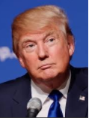
Fine-Grained Entity Typing
ID | Sentence
S1 | Donald Trump spent 14 television seasons presiding over a business-themed game show, NBC’s The Apprentice
Location
Person
Organization
A few common types
The need of fine grained typing
Features for deeper NLP tasks
Relation extraction (Ling & Weld, 2012)
Assists downstream applications
Question answering
A type hierarchy with 100+ types

Slide 105

Current Distant Supervision: The “Context-Agnostic Label” Challenge
“Context-agnostic” type assignment in training data
Existing work: All labels are “perfect” training labels
root
product
person
location
organization
politician
artist
businessman
...
Entity types from KB
ID | Sentence
S1 | Donald Trump spent 14 television seasons presiding over a business-themed game show, NBC’s The Apprentice
author
actor
singer
S1: Donald Trump
Entity Types: person, artist, actor, author, businessman, politician
Entity:
Donald Trump

Slide 106
Current Distant Supervision: Label-Independence Assumption
Entity types are not independent → correlated
actor
more similar
less similar
singer
politician
Existing studies ignore such correlation information
How to deal with infrequent entity types?
→ “data sparsity” on entity type level
Notes:
Key Point 1:
Key Point 2:

Slide 107

Partial Label Embedding (Ren et al., KDD’16)
Extract Text
Features
Train Classifiers
on De-noised Data
Prediction
on New Data
Label Noise
Reduction
ID | Sentence
S1 | Donald Trump spent 14 television seasons presiding over a business-themed game show, NBC’s The Apprentice
Text features: HEAD_Donald, CXT_A: television, CXT_A: season, POS: NN, TKN_trump, SHAPE: AA
S1: Donald Trump
Entity Types: person, artist, actor, author, businessman, politician
De-noised
labeled
data
“Robust”
classifier
X. Ren et al. Label Noise Reduction in Entity Typing by Heterogeneous Partial-Label Embedding. KDD, 2016

Slide 108
PLE: Modeling Clean and Noisy Mentions Separately
For a clean mention, its “positive types” should be ranked higher than all its “negative types”
ID | Noisy Entity Mention
S1 | Donald Trump spent 14 television seasons presiding over a business-themed game show, NBC’s The Apprentice
Types ranked
“Best” candidate type
(+) actor
(-) singer
(-) coach
(-) doctor
(-) location
(-) organization
(+) actor 0.88
(+) artist 0.74
(+) person 0.55
(+) author 0.41
(+) politician 0.33
(+) business 0.31
S1: Donald Trump
Entity Types: person, artist, actor, author, businessman, politician
For a noisy mention, its “best candidate type” should be ranked higher than all its “non-candidate types”
Measured based on currently estimated embedding space
Notes:
Use an example embedding space here to replace the formula.

Slide 109
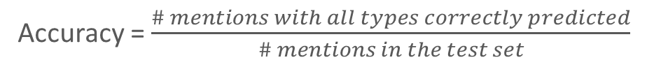
PLE: Performance of Fine-Grained Entity Typing
Accuracy = $\frac{\# mentions with all types correctly predicted}{\# mentions in the test set}$
Raw: candidate types from distant supervision
WASBIE (Google, ACL’14): joint feature and type embedding
PTE (MSR, WWW’15): joint mention, feature and type embedding
Both WASBIE and PTE suffer from context-agnostic labels
PLE (KDD’16): partial-label loss + type correlation modeling
OntoNotes dataset (Weischedel et al. 2011, Gillick et al., 2014): 13,109 news articles, 77 annotated documents, 89 types
https://catalog.ldc.upenn.edu/LDC2013T19

Slide 110
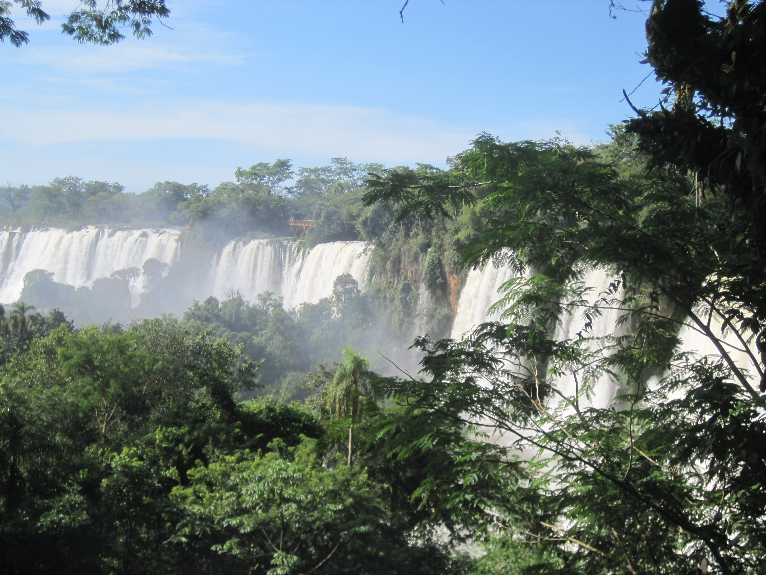

Slide 111
AFET (EMNLP16) and “Type Correlation” Challenge
Distant supervision: Existing studies ignore type correlations
In reality, entity types are not independent → correlated
AFET: Automatic Fine-Grained Entity Typing by Hierarchical Partial-Label (EMNLP’16)
actor
How to deal with infrequent (fine-grained) entity types?
more similar
less similar
singer
politician
Jointly embed entity mentions and type labels into a low-dimensional vector space (to capture type semantics)
Design a noise-robust loss function to model “false positive” type labels in noisy training data
Enforce adaptive margin on entity mentions, to encode type correlation

Slide 112
AFET (EMNLP’16): Framework Overview
Extract Text
Features
Joint Embedding
on Training Sets
Prediction
on New Data
Partition
Training Set
ID | Sentence
S1 | Donald Trump spent 14 television seasons presiding over a business-themed game show, NBC’s The Apprentice
Text features: HEAD_Donald, CXT_A: television, CXT_A: season, POS: NN, TKN_trump, SHAPE: AA
S1: Donald Trump
Entity Types: person, artist, actor, author, businessman, politician
Noisy mention
S4: Ted Cruz
Entity Types: person, politician
Clean mention
text feature
type label
X. Ren et al. AFET: Automatic Fine-Grained Entity Typing by Hierarchical Partial-Label. EMNLP, 2016.

Slide 113
Type Inference in AFET
Top-down nearest neighbor search in the given type hierarchy
ID | Sentence
S2 | Governor Arnold Schwarzenegger gives a speech at Mission Serve's service project on Veterans Day 2010.
Test mention:
S1_Arnold Schwarzenegger
Governor
gives
speech
=
+
+
…
+
Learned embeddings for text features

Slide 114
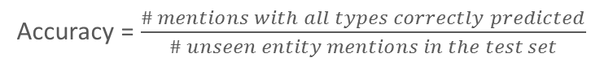
AFET: Performance of Fine-Grained Entity Typing
Accuracy = $\frac{\# mentions with all types correctly predicted}{\# unseen entity mentions in the test set}$
Methods | Wikipedia | OntoNotes | BBN
FIGER (UW, AAAI’12) | 0.474 | 0.369 | 0.467
HYENA (Max-Planck, COLING’12) | 0.288 | 0.249 | 0.523
WASABIE (Google, ACL’14) | 0.480 | 0.404 | 0.619
HNM (IBM, EMNLP’15) | 0.237 | 0.122 | 0.551
PTE (MSR, WWW’15) | 0.405 | 0.436 | 0.604
PL-SVM (Cornell, KDD’08) | 0.428 | 0.225 | 0.465
AFET (EMNLP’16) | 0.533 | 0.551 | 0.670
Fine-grained
classifiers
Embedding- based Methods
Partial-label
Learning
Partial-label loss for modeling noisy labels (vs. fine-grained classifier, embedding methods)
Adaptive margins for capturing type correlation (vs. PL-SVM, all )
Wikipedia dataset (Ling & Weld, 2012): 1.5M sentences, 113 types
OntoNotes dataset (Weischedel et al. 2011, Gillick et al., 2014): 13,109 news articles, 89 types
BBN dataset (Weischedel & Brunstein, 2005): 2,311 news articles, 93 types

Slide 115


Slide 116
Outline
Why Text to Networks?
Phrase Mining and Topic Modeling from Large Text Corpora
Why Phrase Mining
Previous Approaches
TopMine
SegPhrase and AutoPhrase
Entity Recognition and Typing for Massive Text Data
ClusType: Entity Extraction and Typing by Relational Graph Construction and Propagation
Refined Entity Typing: PLE and AFET
CoType: Joint Typing of Entities and Relations

Slide 117

Joint Extraction of Typed Entities and Relations
protest
Washington
D.C.
located at
The Women’s March was a worldwide protest on January 21, 2017. The protest was aimed at Donald Trump, the recently inaugurated president of the United States. The first protest was planned in Washington, D.C., and was known as the Women‘s March on Washington.
aim at
located at
Donald
Trump
Women’s
March
president of
located at
United States
Washington
Person
Location
Organization
Event
Notes:
Concrete example on clarifying input/output of the problem (News on “women’s march”). Clarify concepts: entities/nodes, relationships/edges, StructNet.
Before we answer this question, let’s first clarify what is factual information. To be more specific, I am interested in two kinds of factual structures. First are the real-worlds entities of different categories. For example: Barack Obama is a person, Hawaii is a location; Second, I am also interested in capturing different relations between entities that are expressed in text. For example, one possible relationship between Barack Obama and Hawaii could be “Barack Obama was born in Hawaii”
To unify the factual knowledge in a given corpus, I use a structured network. For the ease of reference, let’s call it StructNet. In a StructNet, nodes represent entities of different entity types; Edges represent entity relationships of different relation types;

Slide 118
Prior Work: An “Incremental” System Pipeline
Error propagation cascading down the pipeline
Entity mention
detection
Context-aware
entity typing
Relation mention detection
Context-aware
relation classification
Entity boundary errors:
The Women’s March was a worldwide protest on January 21, 2017.
Entity type errors:
The Women’s March was a worldwide protest on January 21, 2017. →
person
✗
Relation mention errors:
(women, protest) ✗
(protest, January 21, 2017)
Relation type errors
Relation type errors
✗
is a
✗
is a
(women, protest) →
(protest, January 21, 2017)
Notes:
Re-make the examples

Slide 119

CoType: Joint Extraction of Typed Entities and Relations with Knowledge Bases (WWW’17)
Entity mention detection
1. Data-driven detection of entity and relation mentions
Relation instance detection
Data-driven text segmentation
POS pattern learning from KBs
Context-aware
entity typing
2. Joint typing of entity and relation mentions
Knowledge Bases
Context-aware
relation typing
Noise-robust type modeling
Object “translating” function to model entity-relation interactions
X. Ren et al. CoType: Joint Extraction of Typed Entities and Relations with Knowledge Bases. WWW, 2017.
Notes:
Joint extraction of entities and relations by distant supervision → reduce error propagation

Slide 120
CoType: Co-Embedding for Typing Entities and Relations
Object interactions in a heterogeneous graph
Low-dimensional vector spaces
Notes:
Simplify the example to be more readable.

Slide 121
Modeling Mention-Feature Co-Occurrences
Second-order Proximity
Mentions with similar distributions over text features should have similar types
Vertex m_{i} and m_{j} have a large second-order proximity
president of
???
S7: (Donald Trump, United States)
S6: (Trump, US)
m_{i}
m_{j}
TKN_
Trump
EM2_US
BETWEEN_president
EM2_United States
(Tang et al., WWW’15), (Ren et al. WWW’17)
Notes:
Add formulation

Slide 122



Challenge: “Context-Agnostic Label”
ID | Sentence
S1 | Donald Trump was born in Queens, New York, USA on June 14,1946.
S2 | The protest was aimed at Donald Trump, the recently inaugurated president of the United States.
S3 | There is a method to Donald Trump's madness and he laid it all out in his book, “The Art of the Deal.”
root
product
person
location
organization
politician
artist
businessman
...
Entity types from KB
author
actor
singer
Entity 1
Donald Trump
Entity 2
United States
Type labels for relation mention in S2:
E1: Donald J. Trump | E2: United States
E1 Types: person, politician, businessman, author, actor | E2 Types: location, organization
Relations between E1, E2: president of, citizen of, born in
citizen of
Relation types from KB
president of
born in
Surdeanu et al. Multi-instance multi-label learning for relation extraction. EMNLP, 2012.
Notes:
Need to re-draw figure

Slide 123
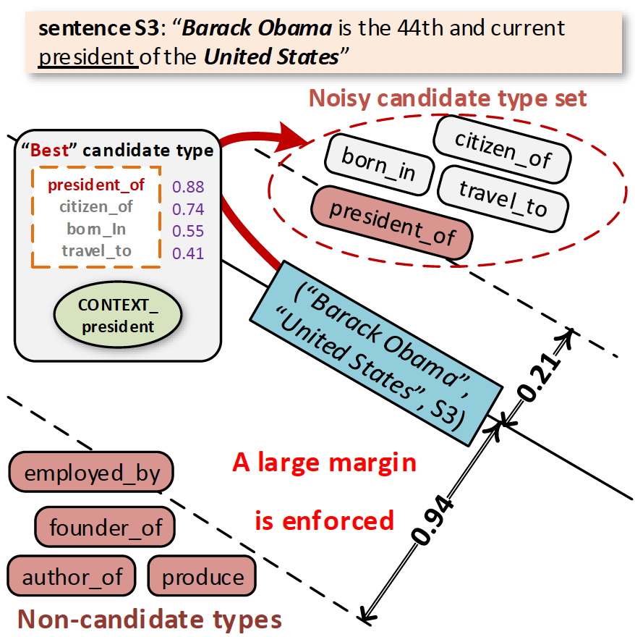
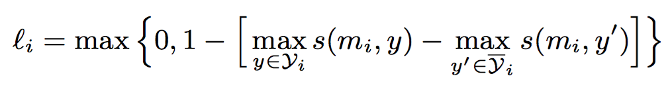
Context-Aware Type Modeling
Partial-label Loss Function
A relation mention should be more similar to its “most relevant” candidate type, than to any other non-candidate type
Enforce: mention is more similar to its “most relevant” candidate type
Score for “most relevant” type
Maximal score for non-candidate types

Slide 124
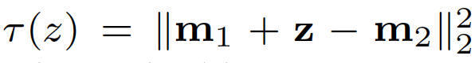
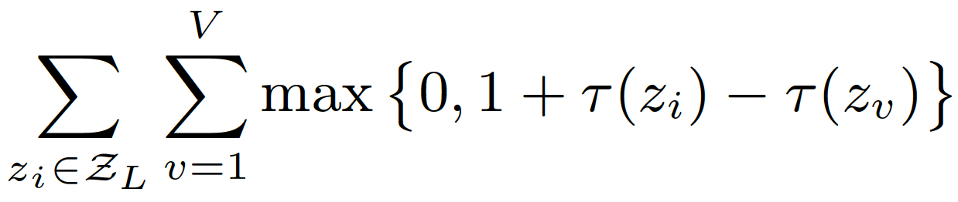
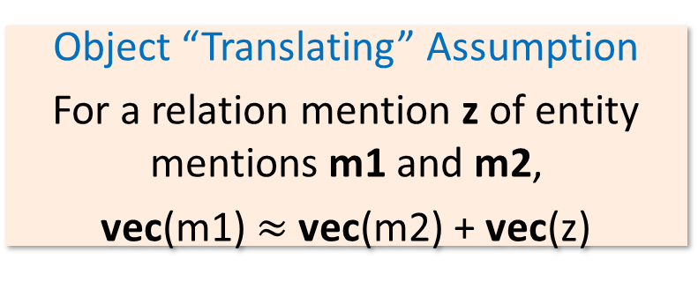
Modeling Entity-Relation Interactions
Error on an entity-relation triple (z, m1, m2):
Object “Translating” Assumption
For a relation mention z of entity mentions m1 and m2,
vec(m1) $≈$ vec(m2) + vec(z)
Enforce: error on a positive triple should be smaller than error on a negative triple
“France”
m1=“USA”
z = capital_city_of
“Paris”
m2=“Washington D.C.”
positive
relation triple
negative
relation triple
Embedding space
Notes:
Use entity-relation interaction to constraint the types of each other, yielding a more robust model

Slide 125
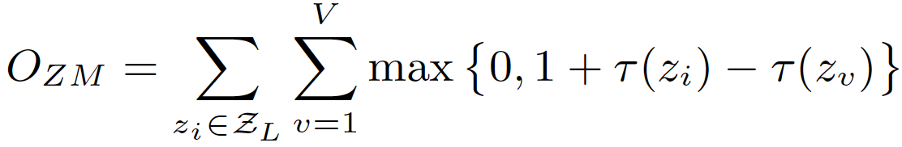
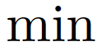
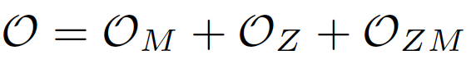
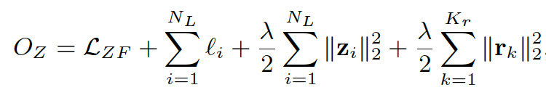
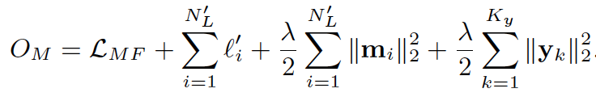
Reducing Error Propagation: A Joint Optimization Framework
Modeling Entity-relation interactions
Modeling relation mentions
Modeling entity mentions
Please refer the paper for details:
X. Ren et al. CoType: Joint Extraction of Typed Entities and Relations with Knowledge Bases. WWW2017.

Slide 126
CoType: Comparing with State-of-the-Arts RE Systems
Given candidate relation mentions, predict its relation type if it expresses a relation of interest; otherwise, output “None”
DeepWalk (StonyBrook, KDD’14): homogeneous graph embedding
DS+Logistic (Stanford, ACL’09): trains logistic classifier on DS
LINE (MSR, WWW’15): joint feature and type embedding
MultiR (UW, ACL’11): distantly-supervised, models noisy labels
CoType-RM (WWW’17): only models relation mentions
CoType (WWW’17): models entity-relation interactions

Slide 127


Slide 128
References on Entity Recognition and Typing
X. Ren, A. El-Kishky, C. Wang, F. Tao, C. R. Voss, H. Ji and J. Han. ClusType: Effective Entity Recognition and Typing by Relation Phrase-Based Clustering. KDD’15
Xiang Ren, Zeqiu Wu, Wenqi He, Meng Qu, Clare Voss, Heng Ji, Tarek Abdelzaher and Jiawei Han, "CoType: Joint Extraction of Typed Entities and Relations with Knowledge Bases", WWW'17
Xiang Ren, Wenqi He, Meng Qu, Lifu Huang, Heng Ji, and Jiawei Han, "AFET: Automatic Fine-Grained Entity Typing by Hierarchical Partial-Label Embedding", EMNLP'16
Xiang Ren, Wenqi He, Meng Qu, Clare R. Voss, Heng Ji, Jiawei Han, "Label Noise Reduction in Entity Typing by Heterogeneous Partial-Label Embedding", KDD'16
H. Huang, Y. Cao, X. Huang, H. Ji and C. Lin. Collective Tweet Wikification based on Semi-supervised Graph Regularization. ACL’14
T. Lin, O. Etzioni, et al. No noun phrase left behind: detecting and typing unlinkable entities. EMNLP’12
N. Nakashole, T. Tylenda, and G. Weikum. Fine-grained semantic typing of emerging entities. ACL’13
R. Huang and E. Riloff. Inducing domain-specific semantic class taggers from (almost) nothing. ACL’10
X. Ling and D. S. Weld. Fine-grained entity recognition. AAAI’12
W. Shen, J. Wang, P. Luo, and M. Wang. A graph-based approach for ontology population with named entities. CIKM’12
S. Gupta and C. D. Manning. Improved pattern learning for bootstrapped entity extraction. CONLL’14
P. P. Talukdar and F. Pereira. Experiments in graph-based semi-supervised learning methods for class-instance acquisition. ACL’10
Z. Kozareva and E. Hovy. Not all seeds are equal: Measuring the quality of text mining seeds. NAACL’10
L. Gal´arraga, G. Heitz, K. Murphy, and F. M. Suchanek. Canonicalizing open knowledge bases. CIKM’14

